Slide 1

Do They Know Us By Our Love?
Being Church Together For The Sake Of The World God Loves

Slide 2

In response to God’s love for us in Jesus Christ,
we advocate for wise and just policies in Pennsylvania that promote the common good.
We equip disciples to live into their baptismal call to
“strive for justice and peace in all the earth.”

Slide 3

LAMPa is a partnership of PA’s synods, seminary, congregations and the Evangelical Lutheran Church in America. Oldest SPPO in the ELCA network – celebrating 47 years of public witness!

Slide 4

Witness in Society
Part of Service and Justice Unit (includes Global Mission, World Hunger and Disaster Response)
Includes offices in Washington, D.C., and UN – Lutheran Office of World Community, as well as SPPOs.
Working for change in public policy based on the experience of Lutheran ministries, programs and projects around the world and in communities across the U.S.
Peacemaking
Hospitality to strangers
Care for creation
Concern for people living in poverty and struggling with hunger and disease.

Slide 5
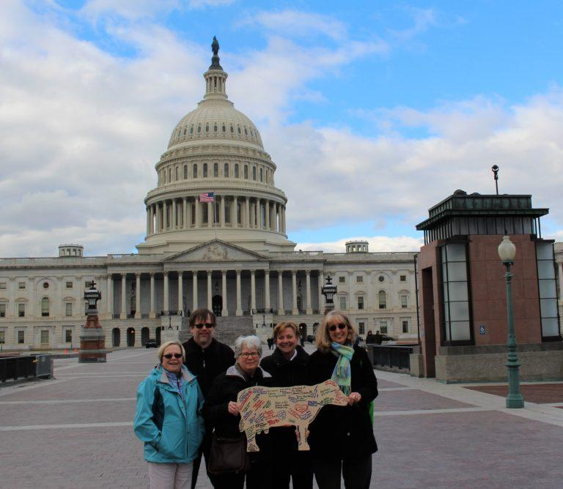
Until All Are Fed
We are partners with ELCA World Hunger.
Majority of LAMPa’s work is focused on ending hunger.
Member of PA Emergency Food Advisory Council, appointed by Secretary of Agriculture
Member of Exec. Committee of the Pa. Hunger Action Coalition

Slide 6
ELCA Social Teachings
Social Statements:
+ Abortion
+Caring for creation
+ Church in society
+The church and criminal justice
+ The death penalty
+ Economic life
+ Education
+ Faith and Civic Life – New!
+ Genetics
+ Health and health care
+Human sexuality
+Peace
+Race, ethnicity and culture
+Sexism
Social Messages:
+ Government
+ Human rights
+ Gender-based violence
+ Mental illness
+ People living with disabilities
+ Terrorism
+Commercial sexual exploitation
+ Suicide prevention
+ Immigration
+ Sexuality
+ Community violence
+ End of life decisions
+ Homelessness
+Israeli/Palestinian conflict
+ AIDS

Slide 7





Join a network to learn more and shape our advocacy together!
Hunger & Poverty
Creation Care
Housing
Made in
God’s Image
Welcoming Communities

Slide 8
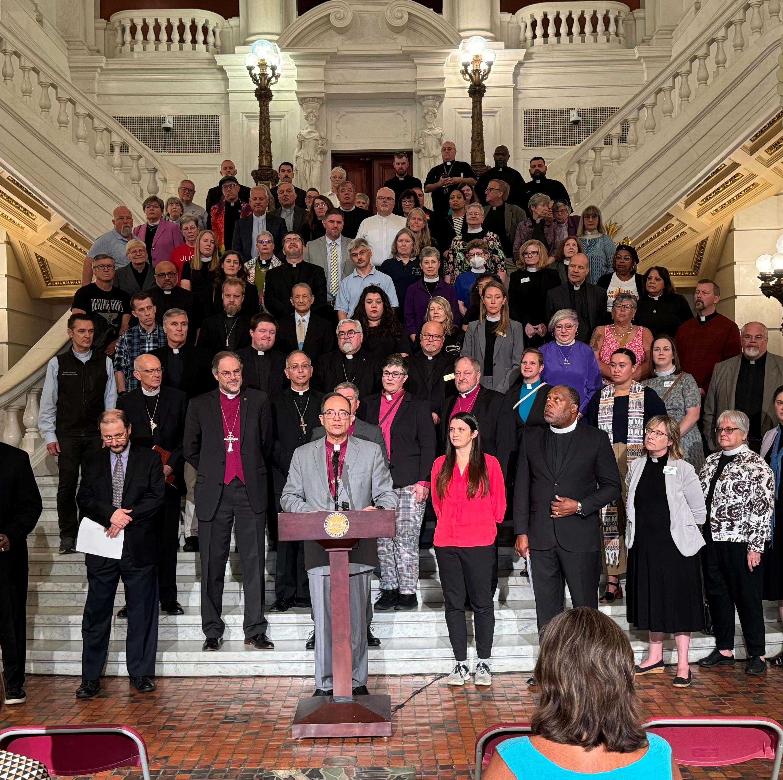
Election Protection and Political Violence Prevention
Work with Common Ground – USA’s Resilient States Project
Horizons Project – Halo
PA Bishops + Partners

Slide 9

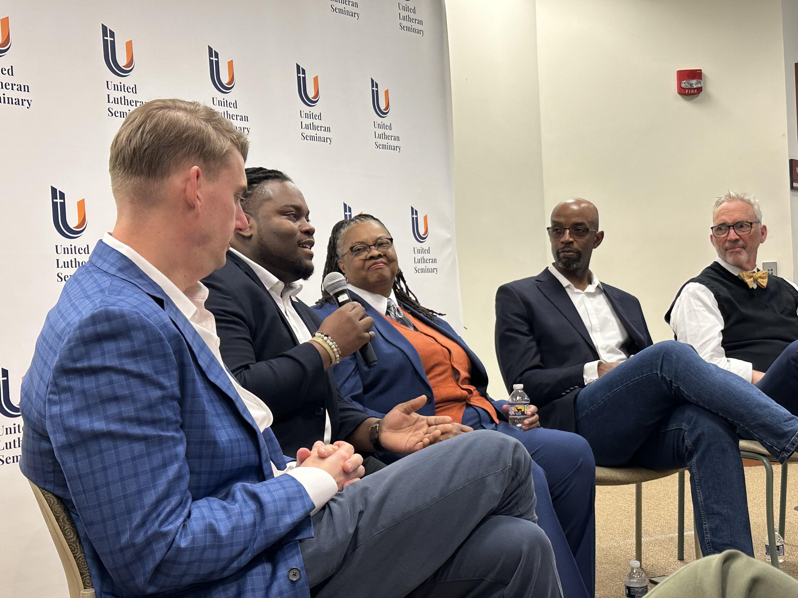
Equipping Disciples
Teaching – Congregational and synod events, conference gatherings, youth events
Resourcing – Webinars and training, e-news, action alerts, GWOH Sunday support, curricula, devotionals
Connecting the church in PA – Lutheran Day in the Capitol, retreats, issue networks

Slide 10
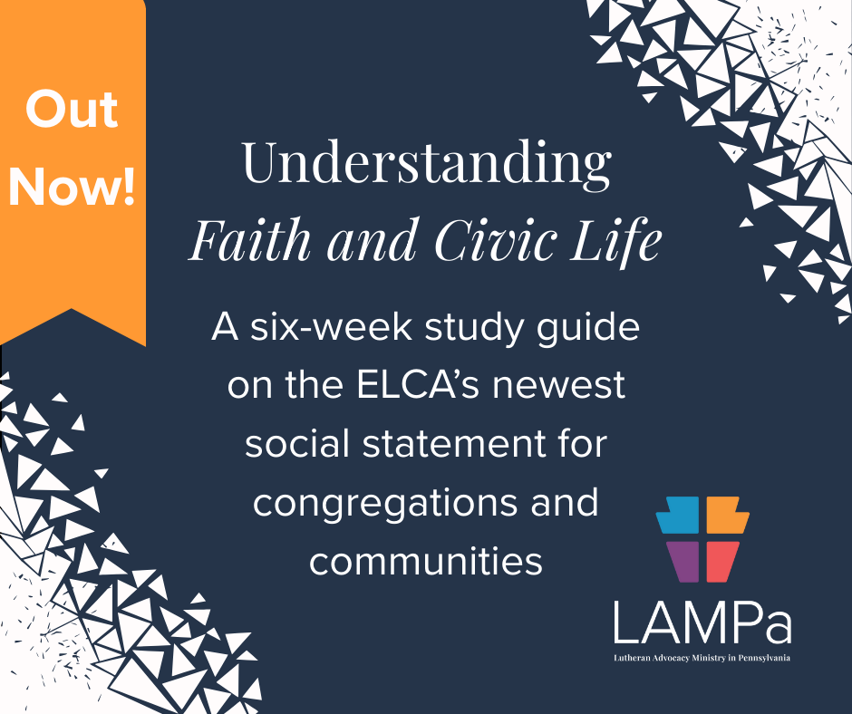
Available for download!

Slide 11
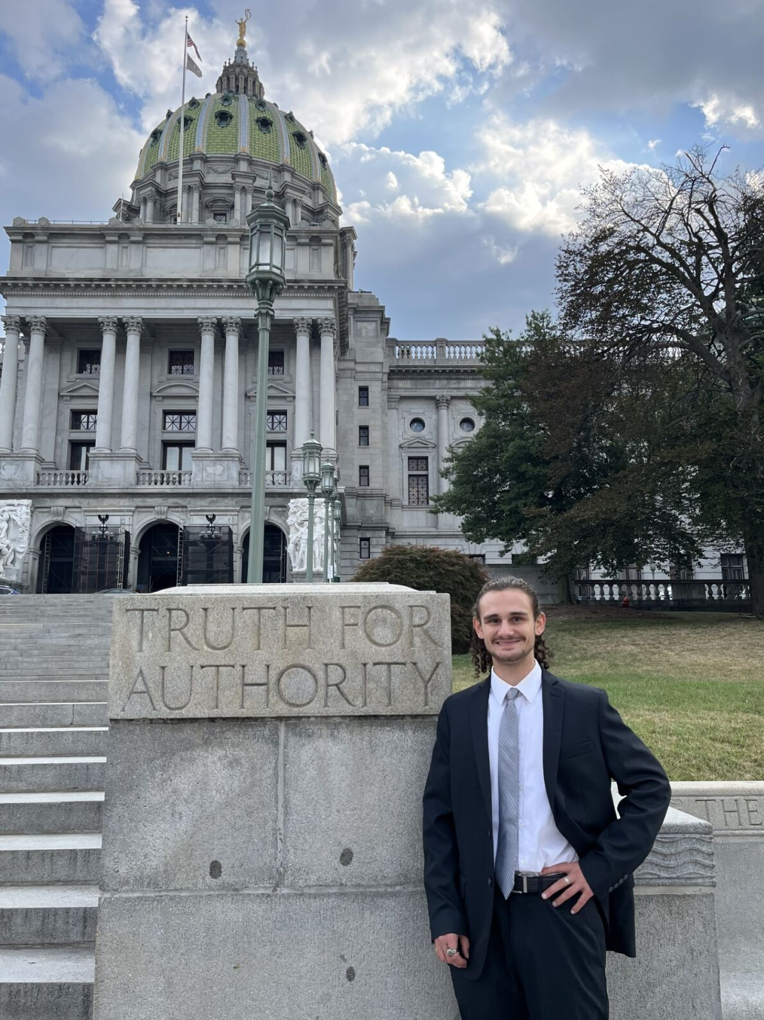
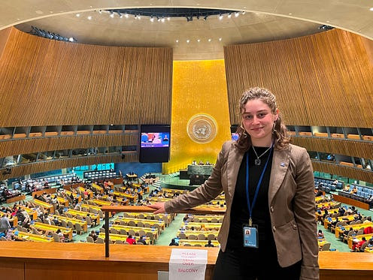
Advocacy Fellowships!

Slide 12

Isaiah 58:12 Racial Justice Fellowship
Empowering Lutheran Youth in Pennsylvania for Racial Reconciliation
Youth and young adults can apply for a grant of up to $500 for projects in their congregation or community to further racial justice and reconciliation and a $1,000 scholarship upon successful completion of the project.
Building on the prophet Isaiah's vision of those who "will be called repairer of the breach, restorer of the streets to live in," this fellowship empowers recipients to address racial injustice and enact reconciliation at the grassroots level.
Each recipient is paired with a clergyperson of color to serve as mentor to bring the project to fruition.
Monthly check-ins with mentors and LAMPa staff, and participation in antiracism training are required parts of the fellowship.
Fellows who successfully complete their projects will then receive $1,000 for college tuition or continuing education.
Applications accepted on rolling basis.

Slide 13
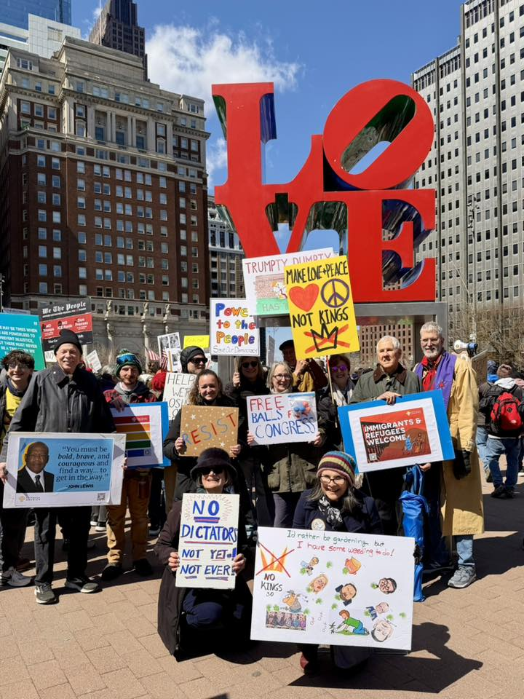
Can you see your people here?

Slide 14
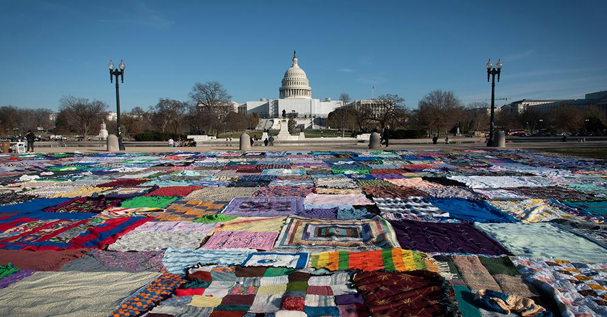
Do you know people who can speak with thread?

Slide 15
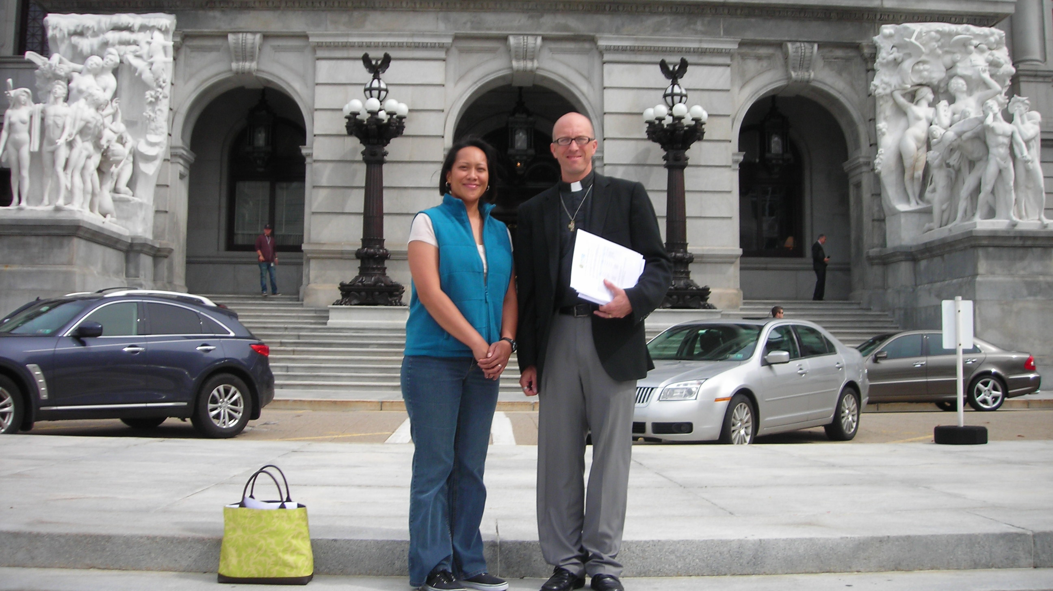
Can you do this?

Slide 16
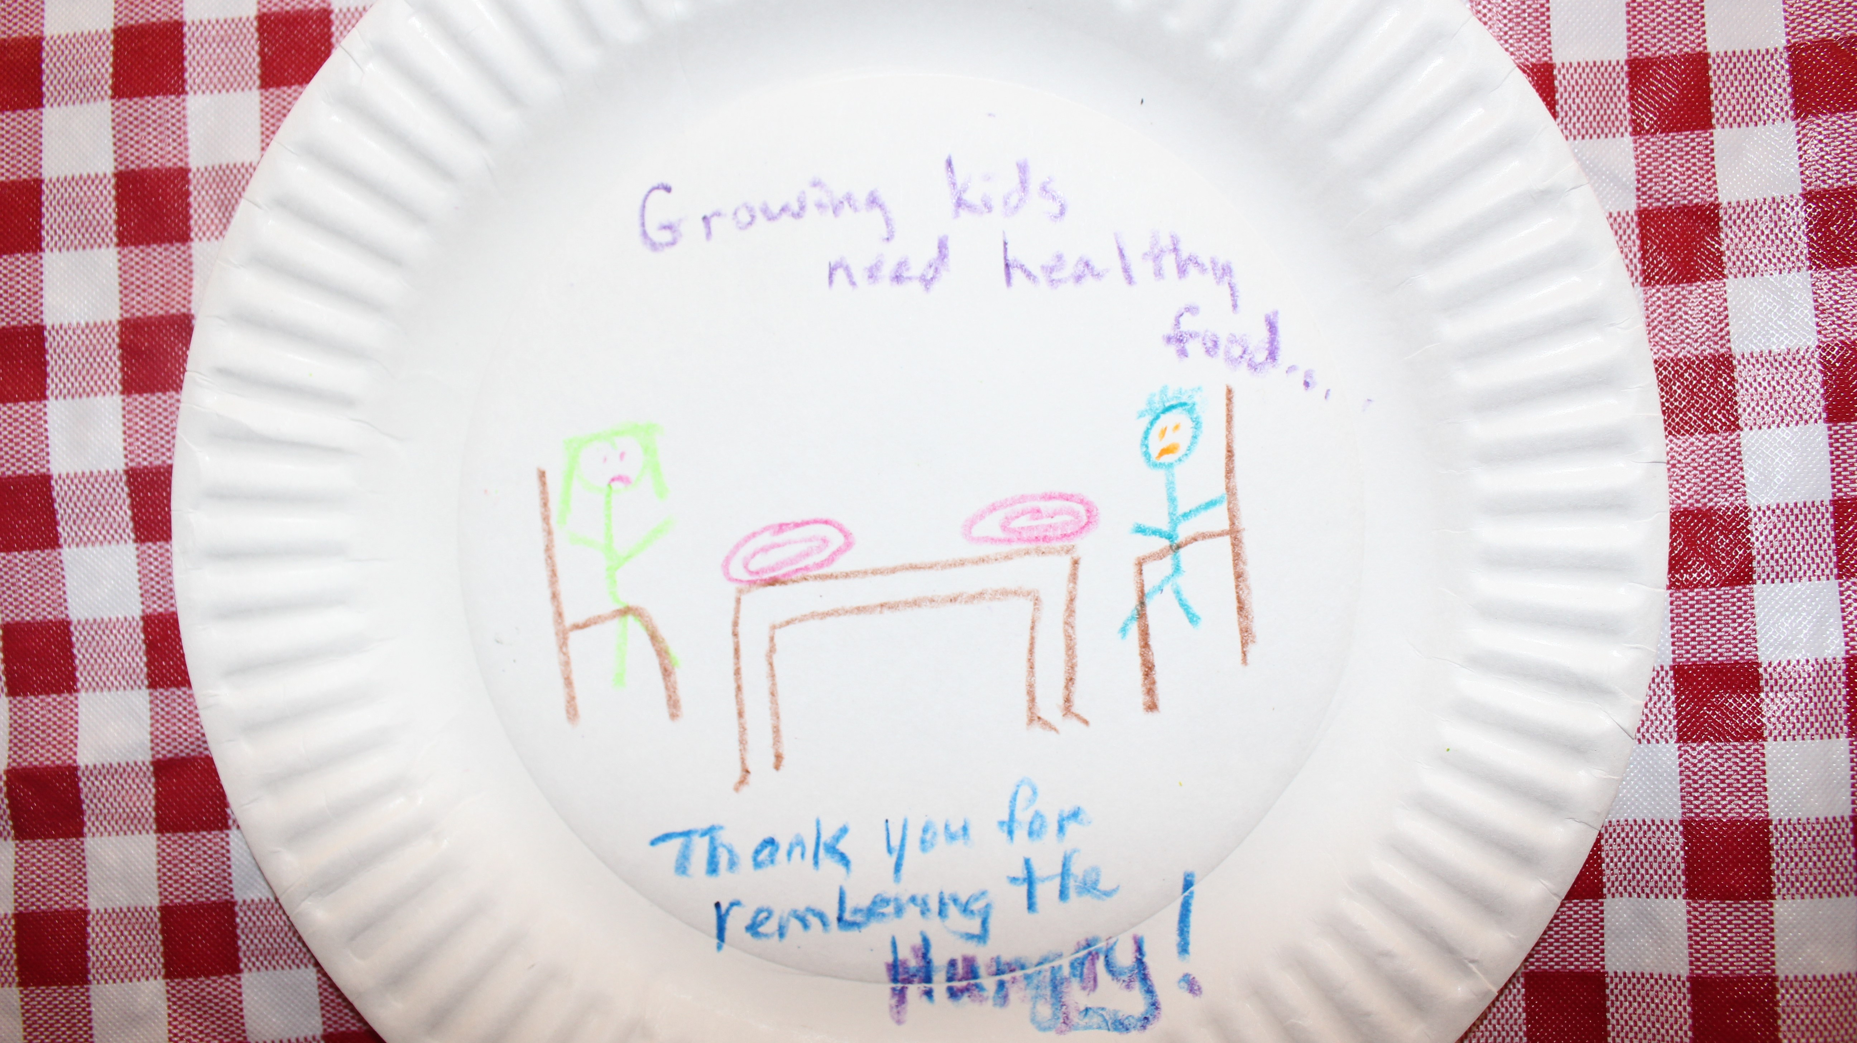
How about this?

Slide 17
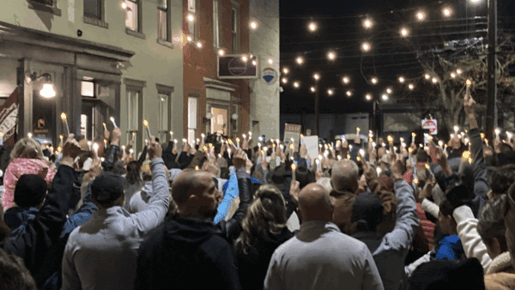
Can you imagine flock here?

Slide 18
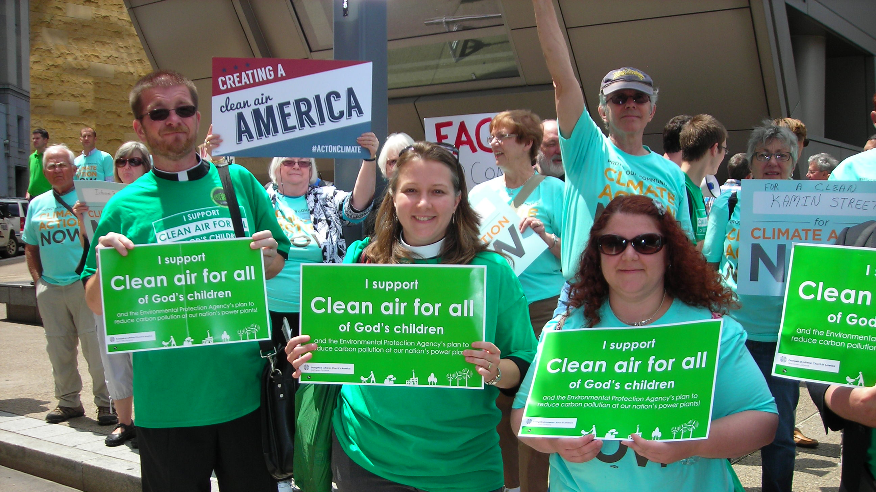
Can you picture yourself here?

Slide 19
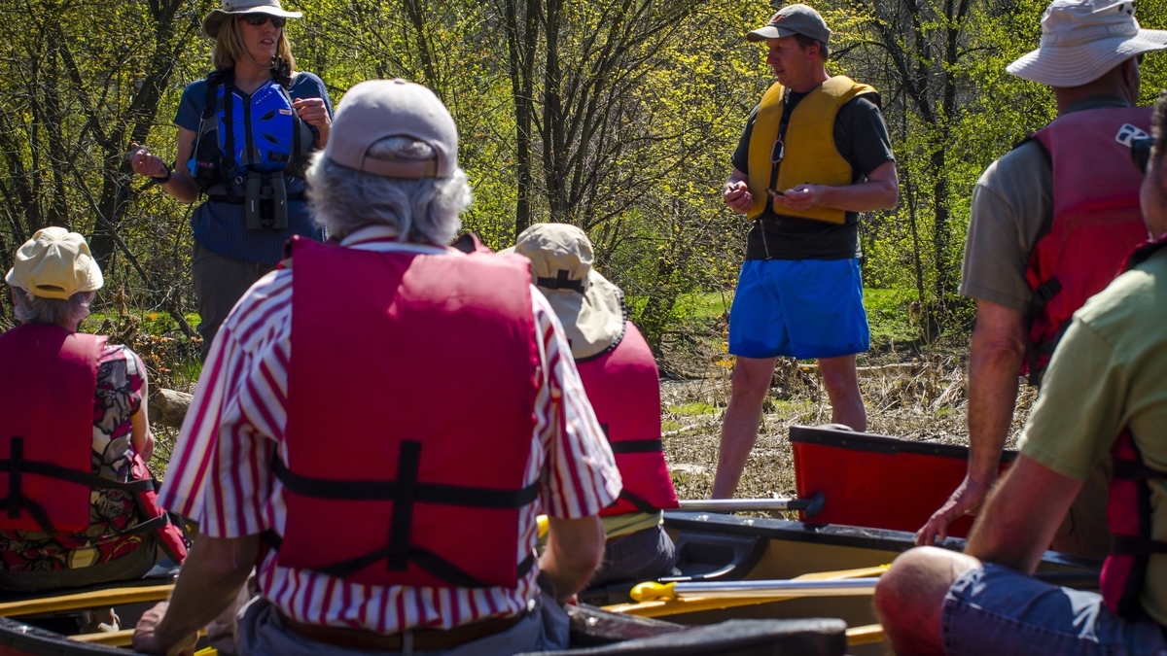
Or here?

Slide 20
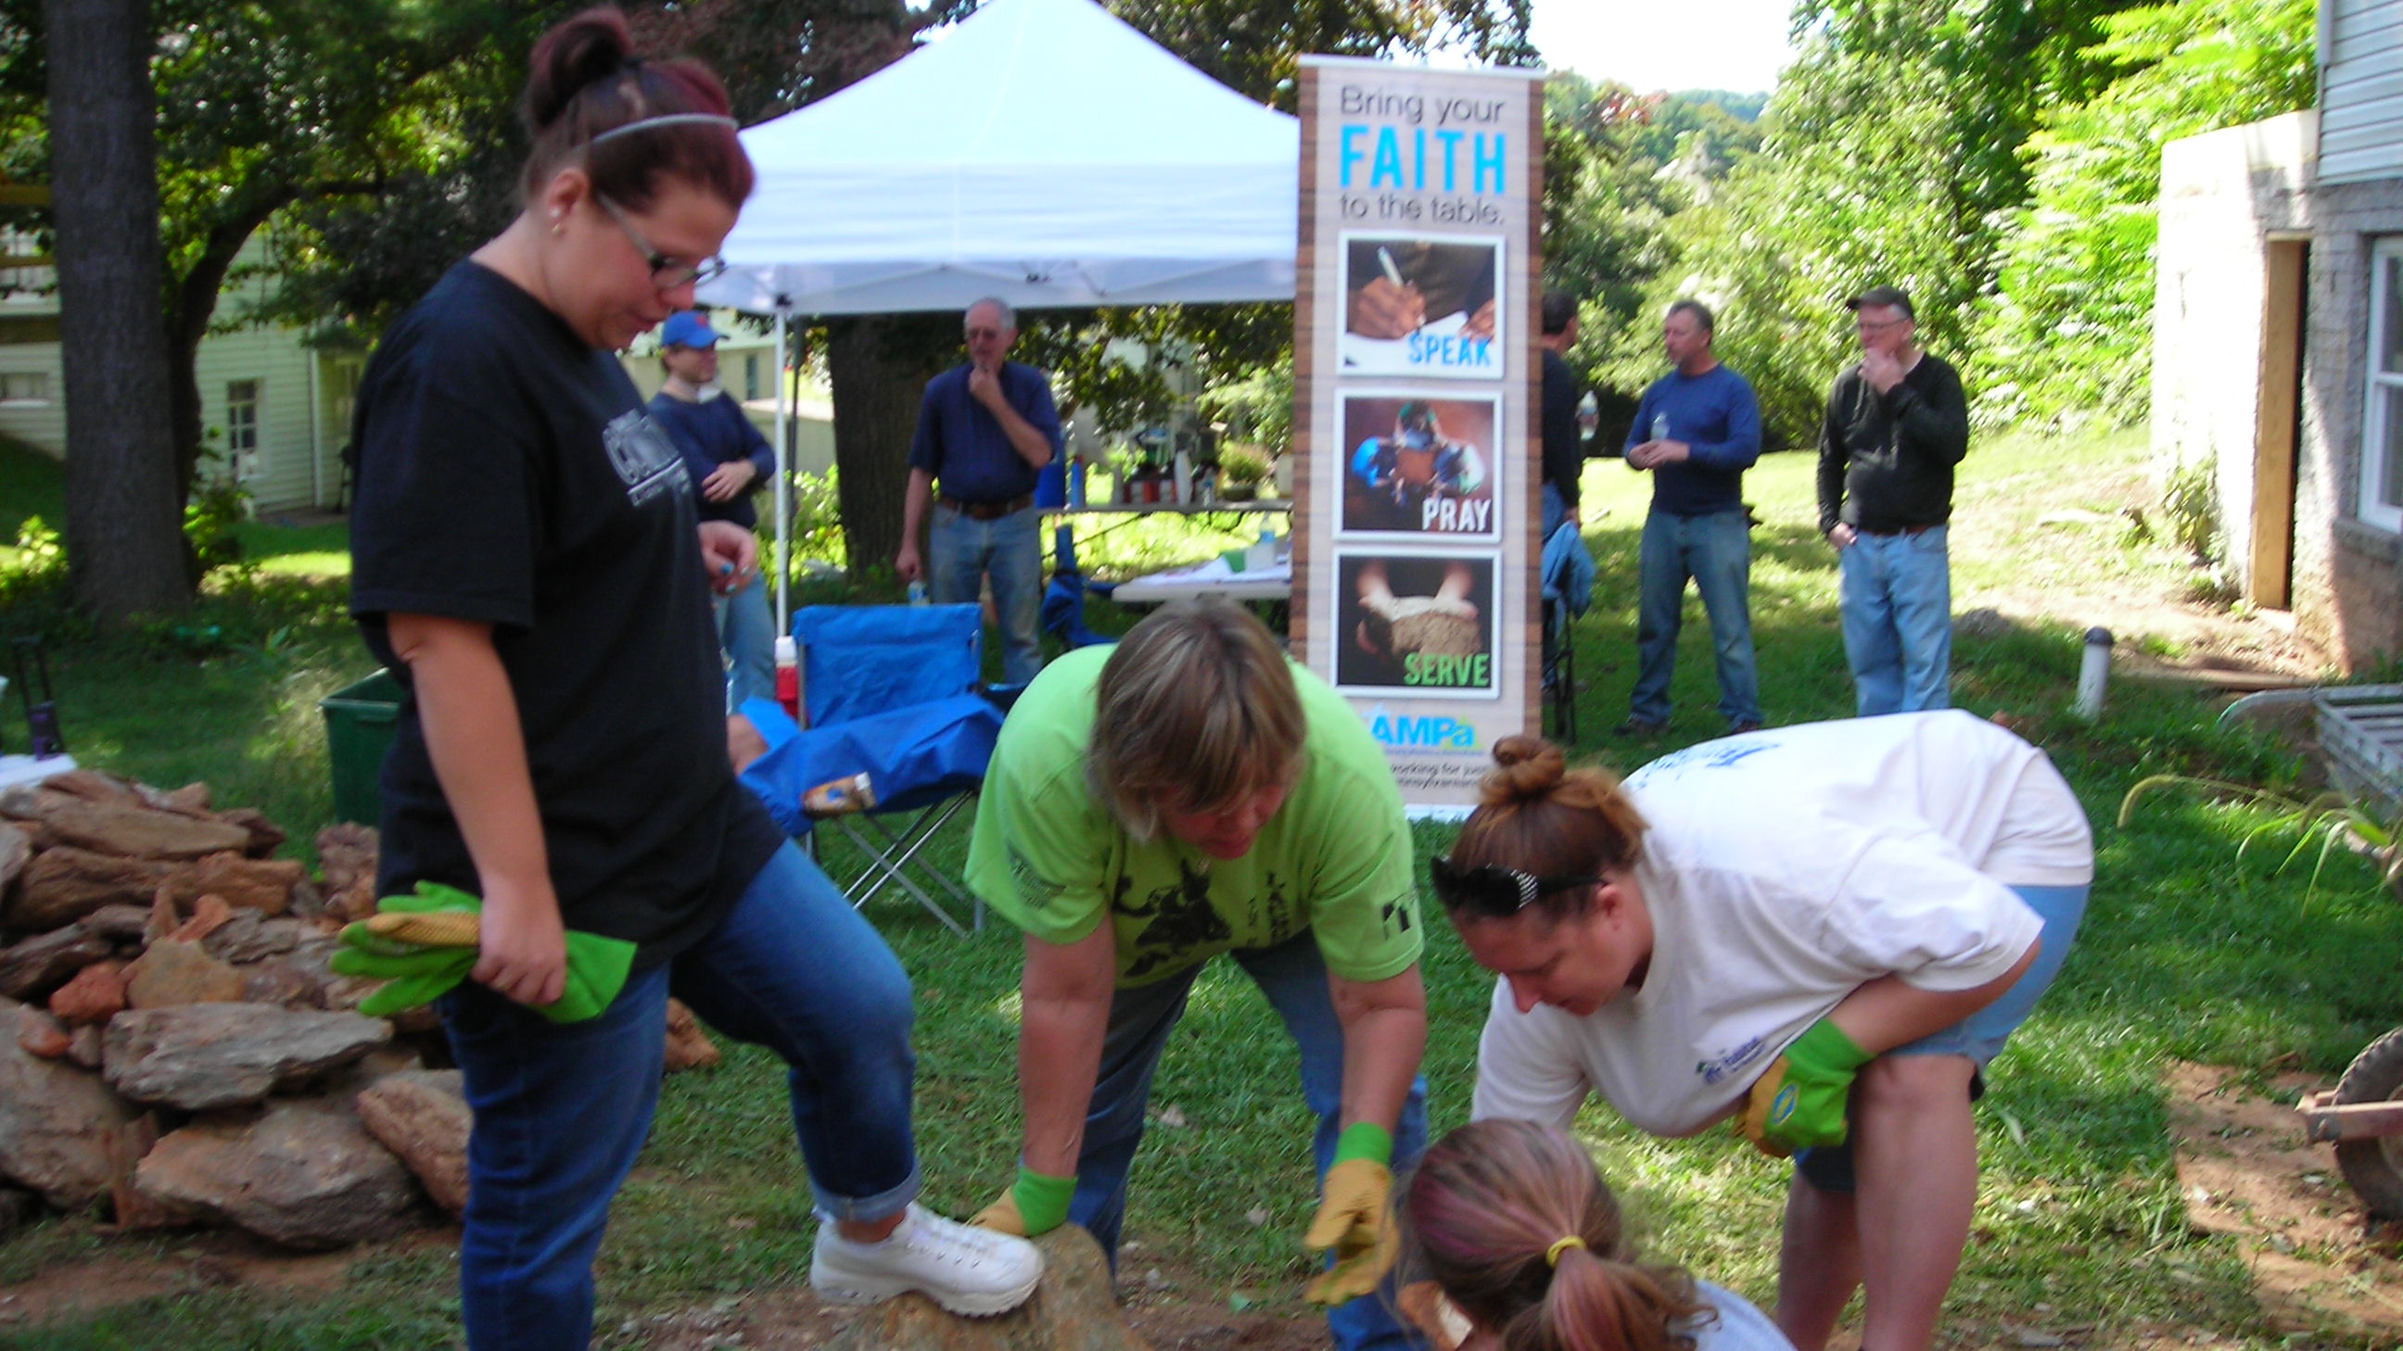
What about here?

Slide 21
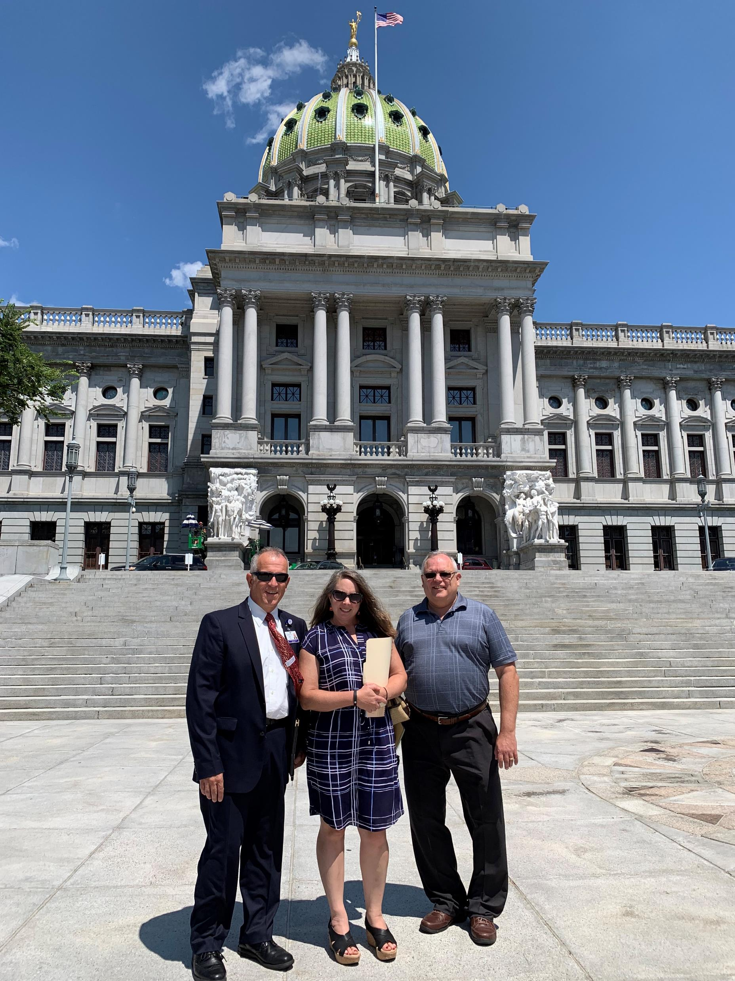
Can you help share the experience of our ministries?

Slide 22
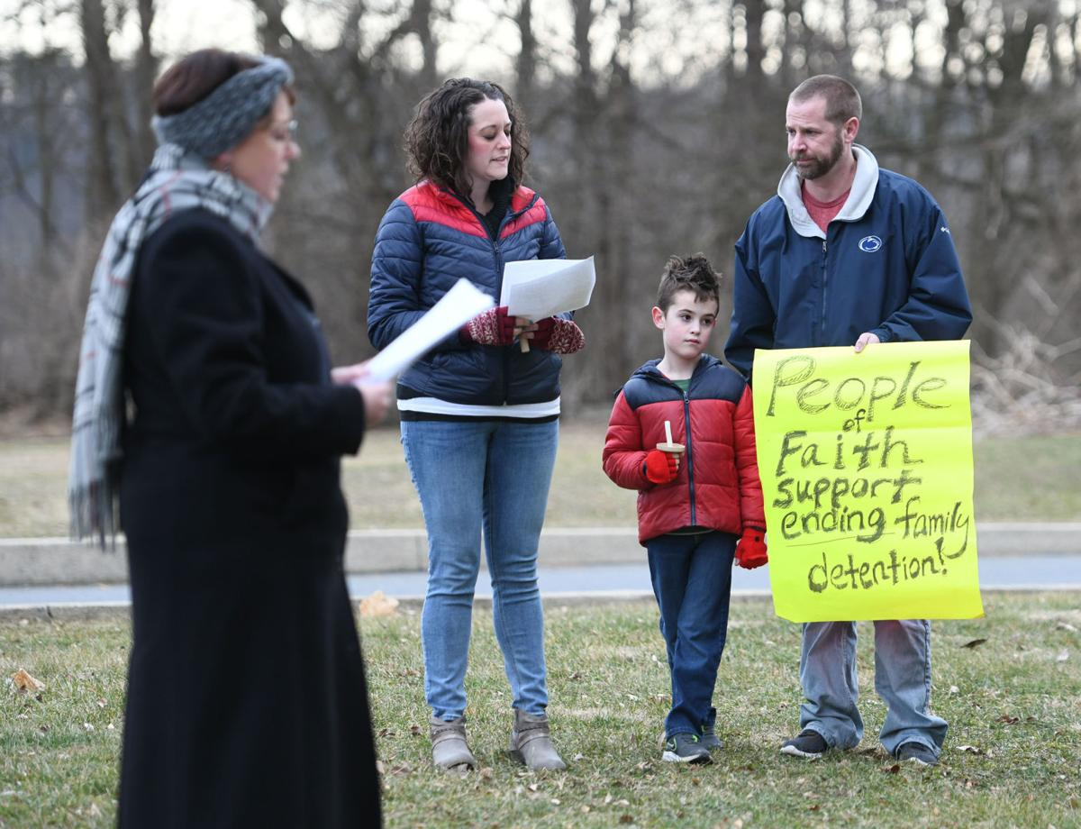
Can you stand with and for your neighbor?

Slide 23
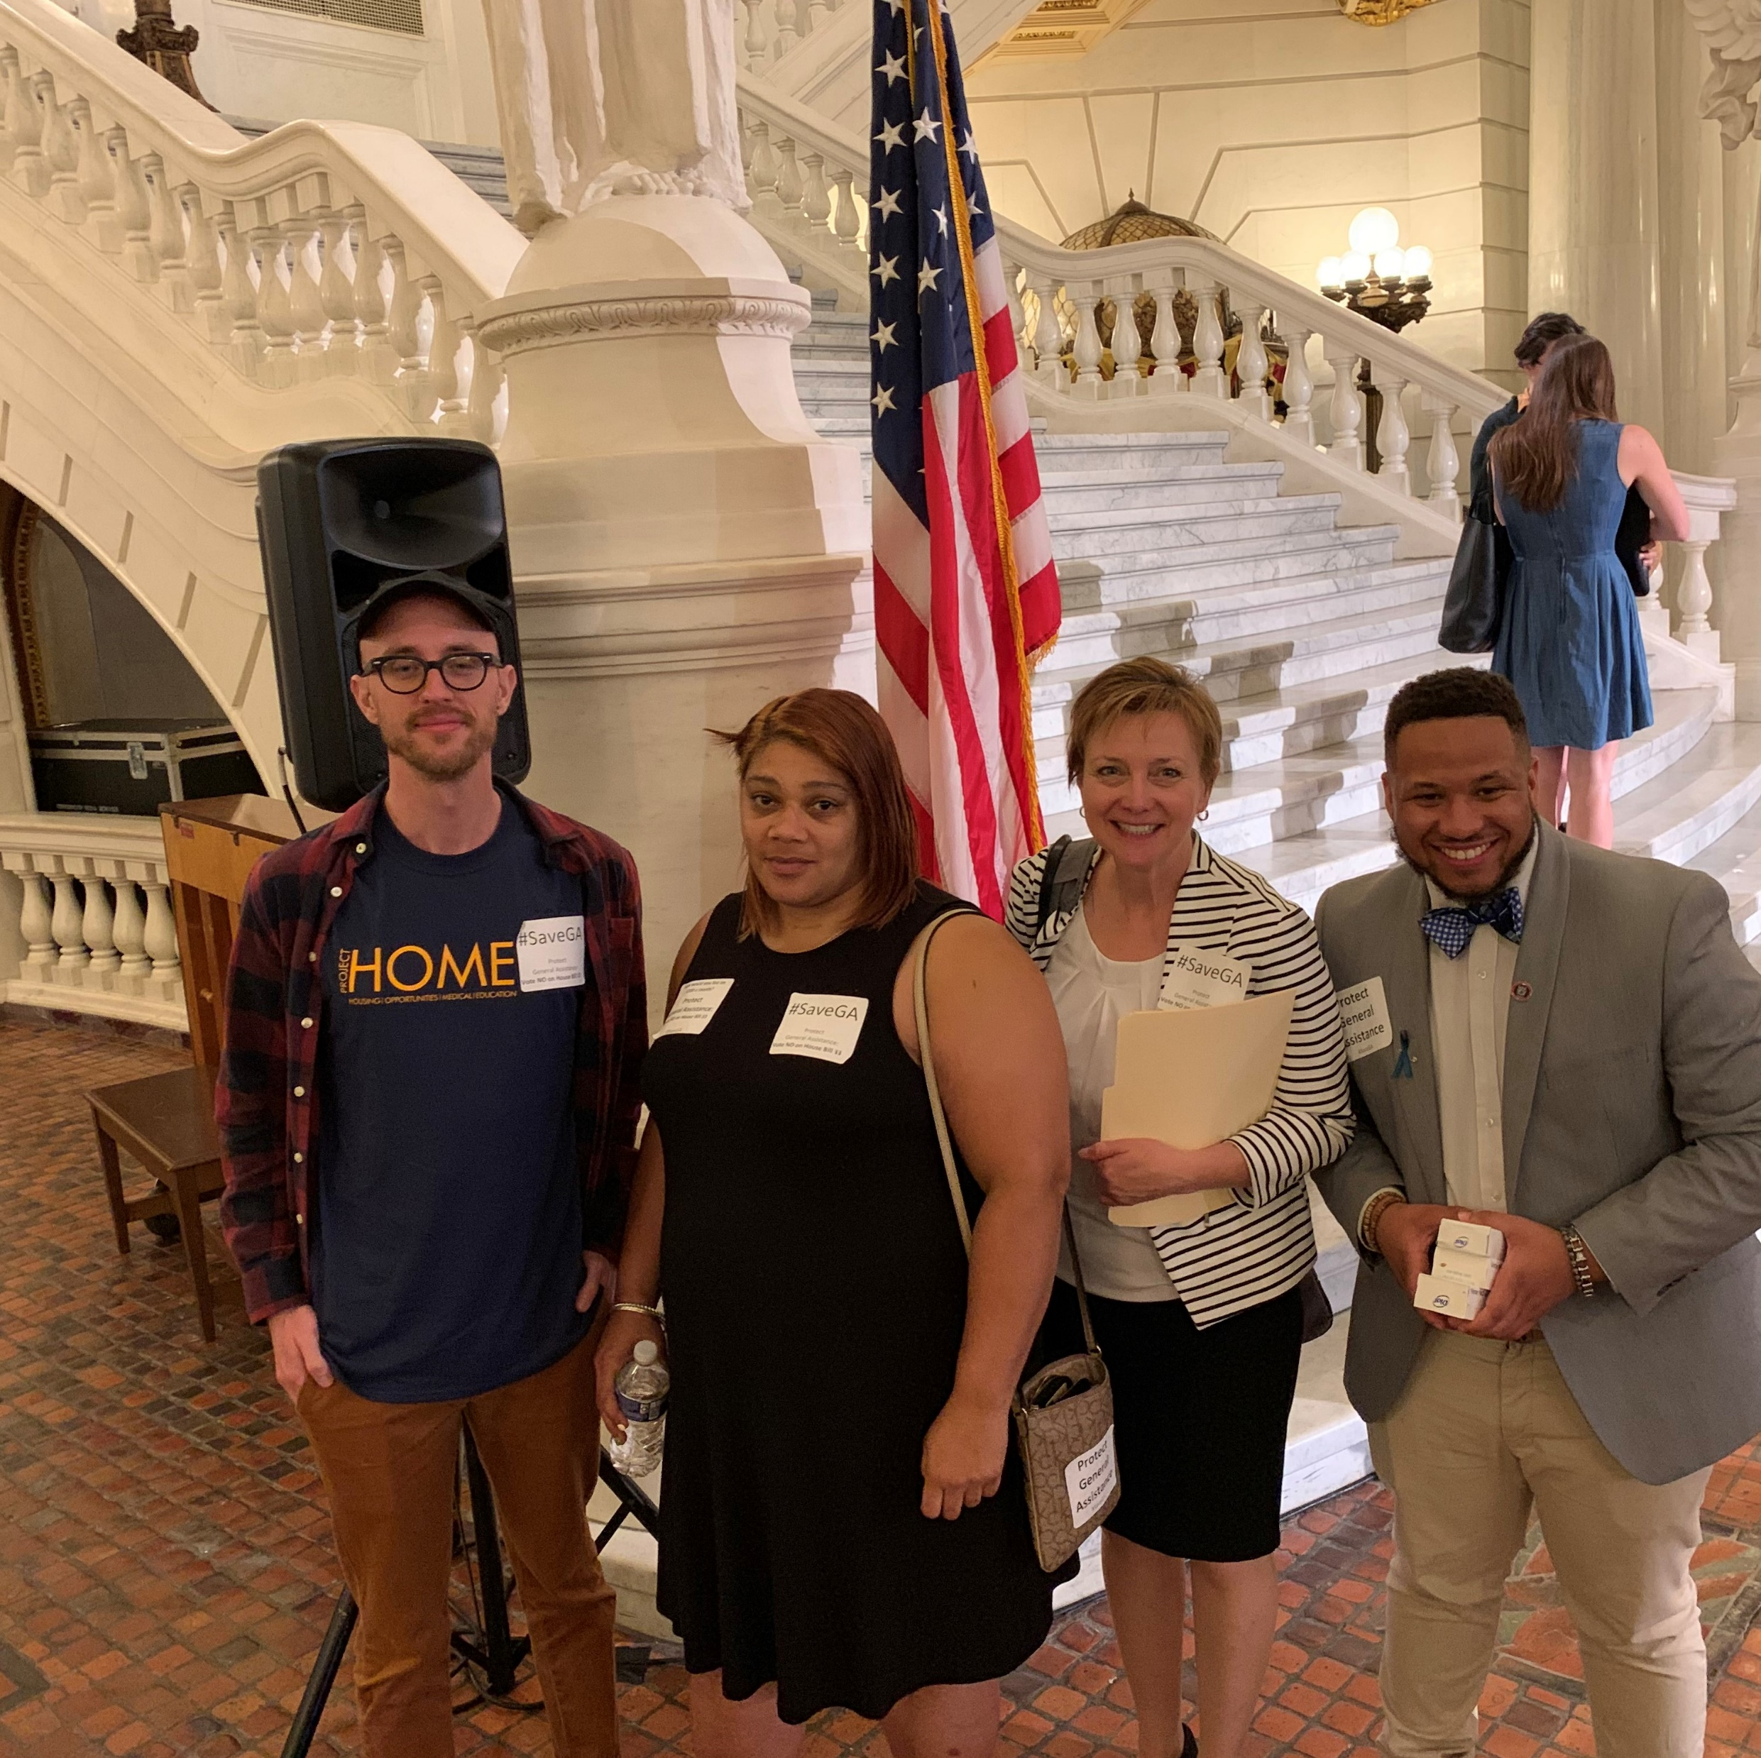
Can you help someone share their story?

Slide 24
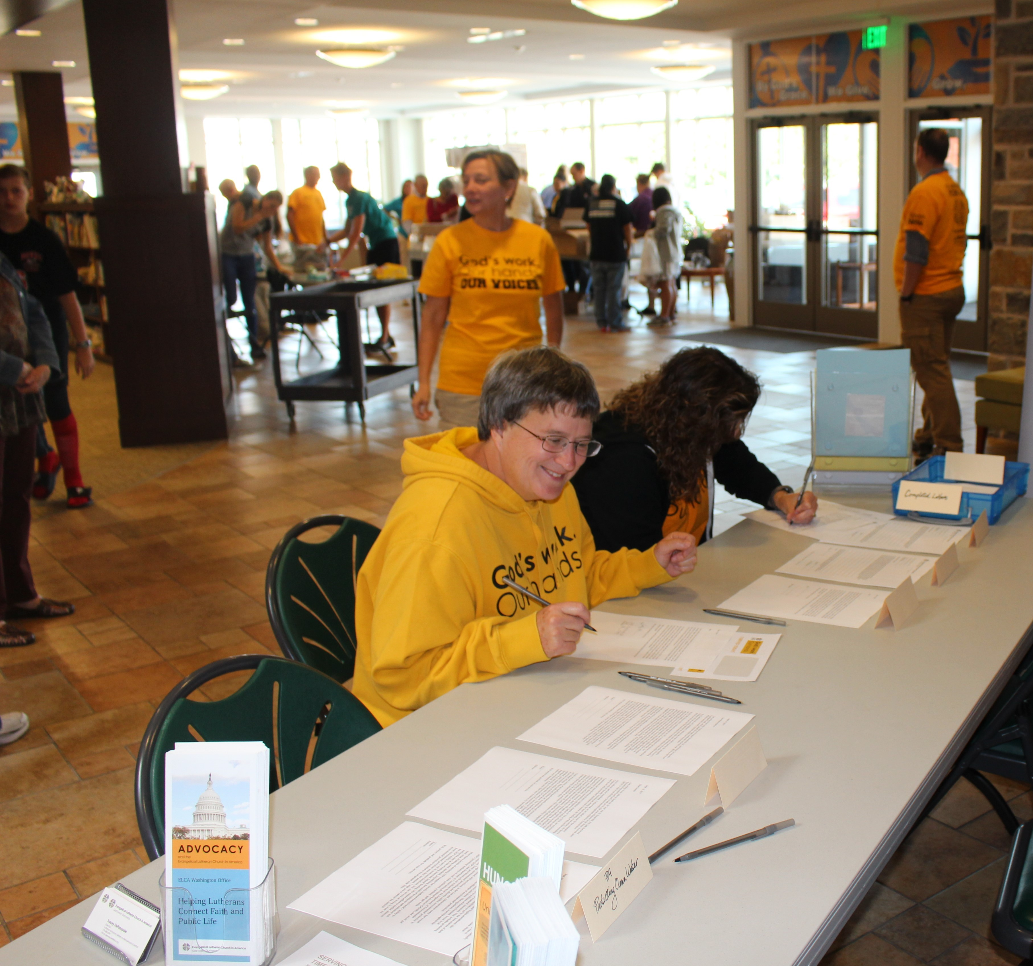
God’s work.
Our hands.
Our voices.
Can you picture this?

Slide 25
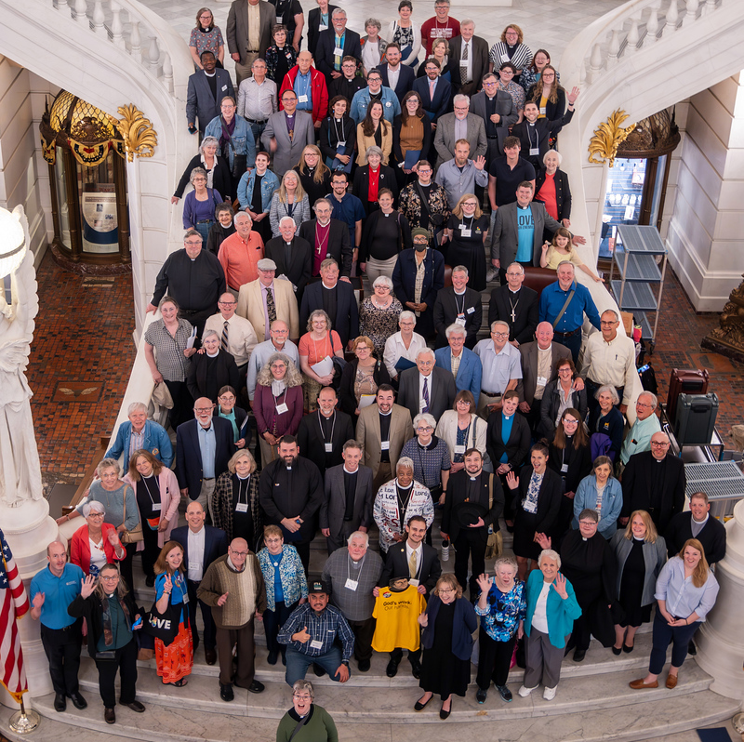
Lutheran Day in the Capitol
Join us April 20, 2026!!!
Begins with learning and worship at Trinity Lutheran Church, Camp Hill
Keynote:
The Rev. Amy Reumann
Preacher:
Bishop Regina Hassanally

Slide 26

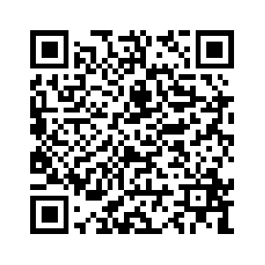
Register by Monday!

Slide 27
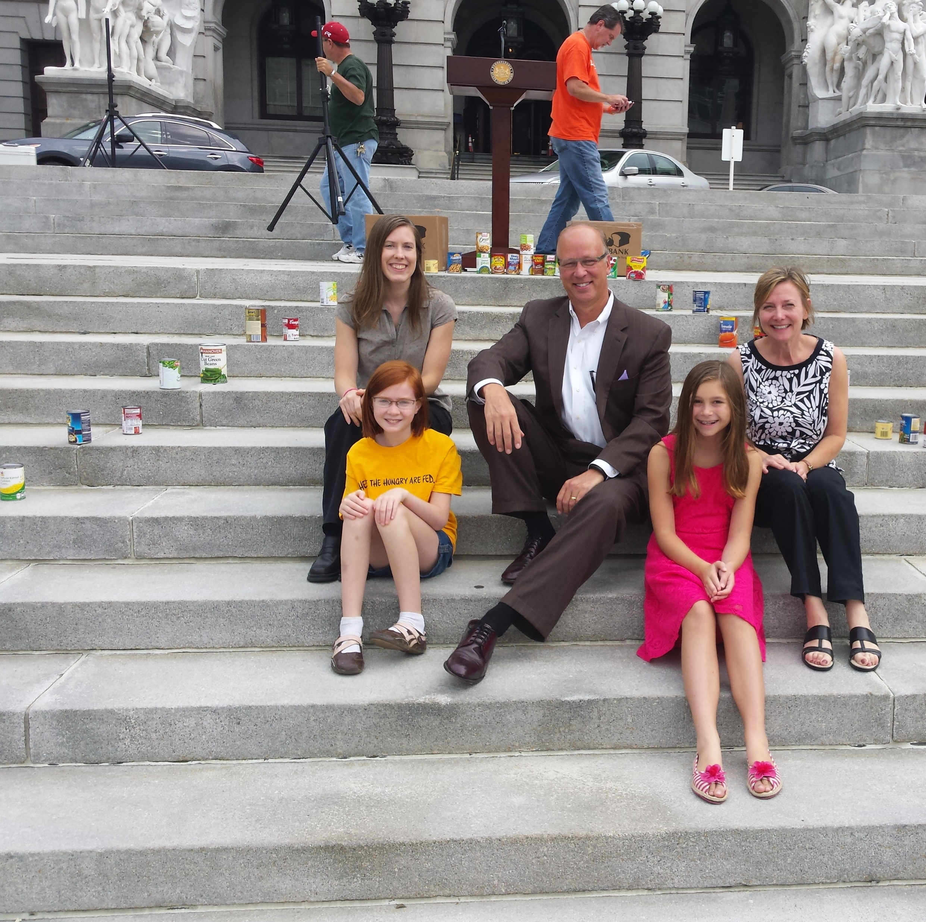
First Steps
PRAY for policymakers.
Develop relationship with policymakers. PLEASE don’t have the first time be about a favor for the congregation.
Invite policymakers to see your ministries of service.
Develop relationship with local media. Be known for your love!
Best advocacy stems from accompaniment. How are you accompanying your neighbor?
Undertake study using social statement on Civic Life and Faith.

Slide 28
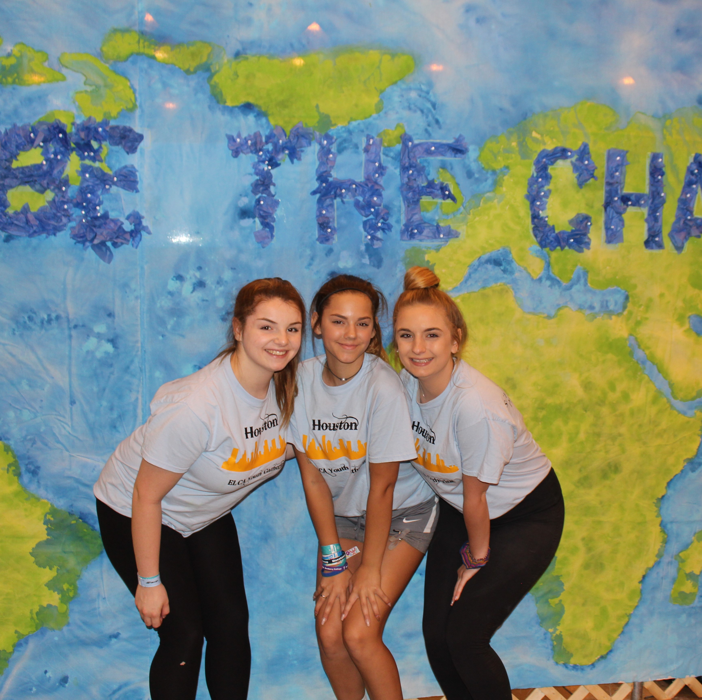
Church Together for the Sake of the World God Loves
Sign up for news and action alerts.
Follow LAMPa on social media.
Help keep ministries on our map!
Join a network or offer a talent.
Add advocacy to “God’s work. Our hands”. Sunday.
Bring a team to Lutheran Day in the Capitol
THANK YOU
for your support of our common ministry!
www.lutheranadvocacypa.org

