Slide 1
Council Officers Gathering

Slide 2
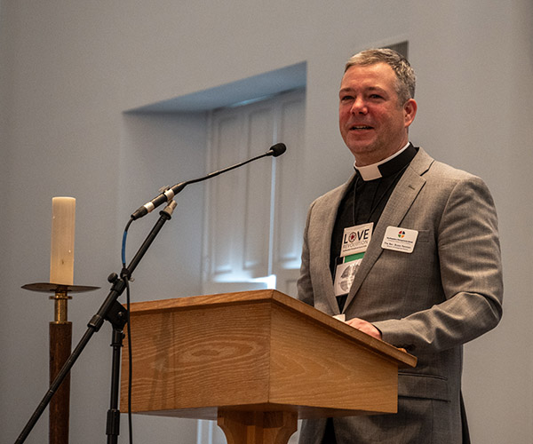
Welcome
A few hospitality notes
Bishops contact information:
The Rev. Bryan Penman (he/him)
Southeastern Pennsylvania Synod, ELCA
7241 Germantown Ave. Philadelphia, PA 19119
Office: 267.323.3756 | Email: bpenman@sepa.org

Slide 3
Your role as council members
The duties of the Congregation Council shall include the following:
To lead this congregation in stating its mission, to do long-range planning, to set goals and priorities, and to evaluate its activities in light of its mission and goals.
To seek to involve all members of this congregation in worship, learning, witness, service, and support

Slide 4
Your role as council members
3. To oversee and provide for the administration of this congregation to enable it to fulfill its functions and perform its mission.
4. To maintain supportive relationships with the rostered minister(s) and staff and help them annually to evaluate the fulfillment of their calling or employment.

Slide 5
Your role as council members
5. To be examples individually and corporately of the style of life and ministry expected of all baptized persons.
6. To promote a congregational climate of peace and goodwill and, as differences and conflicts arise, to endeavor to foster mutual understanding.

Slide 6
Your role as council members
7. To arrange for pastoral service during the sickness or absence of the pastor.
8. To emphasize support of the synod and churchwide organization of the Evangelical Lutheran Church in America as well as cooperation with other congregations, both Lutheran and non-Lutheran, subject to established policies of the synod and the Evangelical Lutheran Church in America.

Slide 7
Your role as council members
9. To recommend and encourage the use of program resources produced or approved by the Evangelical Lutheran Church in America.
10. To seek out and encourage qualified persons to prepare for the ministry of the Gospel.

Slide 8
Executive Officers
President - The President of the congregation shall preside at congregation meetings and Congregation Council meetings. The President, in consultation with the pastor(s) and the officers of the congregation shall be responsible for the appointment of all congregation committee chairpersons
VP - shall function in the role of President whenever that officer is absent or that role unfilled. In addition, the vice president shall chair the Executive Committee, in consultation with the President.
Secretary - The Secretary of the congregation shall keep accurate minutes of all meetings of the congregation and of the Congregation Council in a volume provided by the congregation, which shall be preserved permanently in its archives.
Treasurer - The Treasurer shall keep the books of account of the congregation. The Treasurer shall receive from the Financial Secretary all funds and disburse them on proper orders, making monthly remittance of benevolence receipts to the treasurer of the synod.

Slide 9
The role of the pastor
Every minister of Word and Sacrament shall:
preach the Word;
administer the sacraments;
conduct public worship;
provide pastoral care;
seek out and encourage qualified persons to prepare for the ministry of the Gospel;

Slide 10
The rolE of the pastor
6) impart knowledge of this church and its wider ministry through available channels of effective communication;
7) witness to the Kingdom of God in the community, in the nation, and abroad; and

Slide 11
The rolE of the pastor
8) speak publicly to the world in solidarity with the poor and oppressed, advocating dignity, justice, and equity for all people, working for peace and reconciliation among the nations, caring for the marginalized, and embracing and welcoming racially and ethnically diverse populations.

Slide 12
The rolE of the pastor
Each pastor with a congregational call shall, within the congregation:
1) offer instruction, confirm, marry, visit the sick and distressed, and bury the dead;
2) relate to all schools and organizations of this congregation;
3) install regularly elected members of the Congregation Council;
4) with the council, administer discipline;
5) endeavor to increase the support given by the congregation to the work of the churchwide organization and of the (insert name of synod) ; and
6) encourage adherence to covenantal relationship with this church as expressed in the Constitutions, Bylaws, and Continuing Resolutions of the Evangelical Lutheran Church in America.

Slide 13
The work of the church
To participate in God’s mission, this congregation as a part of the Church shall:
1. Worship God in proclamation of the Word and administration of the sacraments and through lives of prayer, praise, thanksgiving, witness, and service.

Slide 14
The work of the church
2. Proclaim God’s saving Gospel of justification by grace for Christ’s sake through faith alone, according to the apostolic witness in the Holy Scripture, preserving and transmitting the Gospel faithfully to future generations.

Slide 15
The work of the church
3. Carry out Christ’s Great Commission by reaching out to all people to bring them to faith in Christ and by doing all ministry with a global awareness consistent with the understanding of God as Creator, Redeemer, and Sanctifier of all.

Slide 16
The work of the church
4. Serve in response to God’s love to meet human needs, caring for the sick and the aged, advocating dignity, justice, and equity for all people, working for peace and reconciliation among the nations, caring for the marginalized, embracing and welcoming racially and ethnically diverse populations, and standing in solidarity with the poor and oppressed and committing itself to their needs.

Slide 17
The work of the church
5. Nurture its members in the Word of God so as to grow in faith and hope and love, to see daily life as the primary setting for the exercise of their Christian calling, and to use the gifts of the Spirit for their life together and for their calling in the world.

Slide 18
The work of the church
6. Manifest the unity given to the people of God by living together in the love of Christ and by joining with other Christians in prayer and action to express and preserve the unity which the Spirit gives.

Slide 19
The work of the church
*C4.03. To fulfill these purposes, this congregation shall:
a. Provide services of worship at which the Word of God is preached and the sacraments are administered.
b. Provide pastoral care and assist all members to participate in this ministry.

Slide 20
The work of the church
c. Challenge, equip, and support all members in carrying out their calling in their daily lives and in their congregation.
d. Teach the Word of God.
e. Witness to the reconciling Word of God in Christ, reaching out to all people.

Slide 21
The work of the church
f. Respond to human need, work for justice and peace, care for the sick and the suffering, and participate responsibly in society.
g. Motivate its members to provide financial support for this congregation’s ministry and the ministry of the other expressions of the Evangelical Lutheran Church in America.

Slide 22
The work of the church
h. Foster and participate in interdependent relationships with other congregations, the synod, and the churchwide organization of the Evangelical Lutheran Church in America.
i. Foster and participate in ecumenical relationships consistent with churchwide policy.

Slide 23
What the heck is a Synod?
In Greek – SYNODOS, which is made up of "together" (Syn) and "traveling" (hodos) - so a gathering traveling a path together.
The ELCA is made up of 65 synods, all that are geographically boundaried except for the Slovak Zion Synod.
We are a church in 3 expressions: Congregation, Synod and Churchwide.

Slide 24
Doing ministry together
Our Purpose:
Provide Pastoral Care of Congregations and Rostered Leaders
Strengthen Relationships among the 3 expressions of the church as well as with ecumenical partners
Interpret the work of the church to congregations

Slide 25
Doing ministry together
Our Responsibilities:
Approving candidates for ministry and providing for their ordinations.
Supporting leaders of this church both rostered and lay
Supporting the work of rostered leaders

Slide 26
Doing ministry together
Our Responsibilities:
Provide for discipline of rostered and lay leaders
Providing for an archives for the church

Slide 27
SEPA Synod
Mission
Equipping the saints for the work of ministry
(Ephesians 4:12-16)
Vision
Lutherans together: loving God and loving neighbor

Slide 28
SEPA Synod
Core Values
Vitality
Generosity
Leadership Formation
Service and Advocacy
Faith Formation
Evangelism/Story Telling

Slide 29
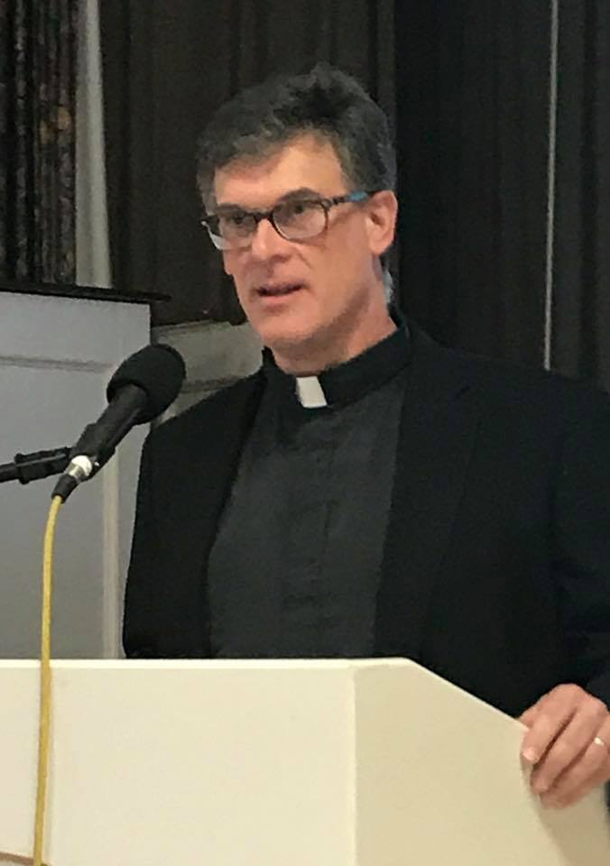
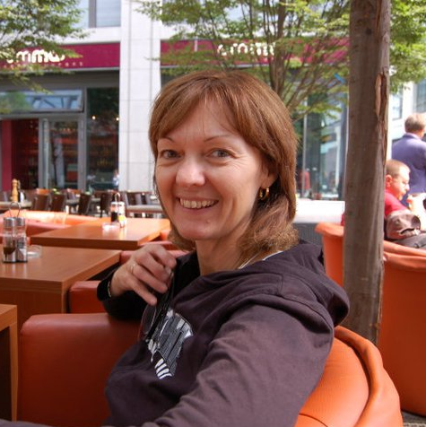
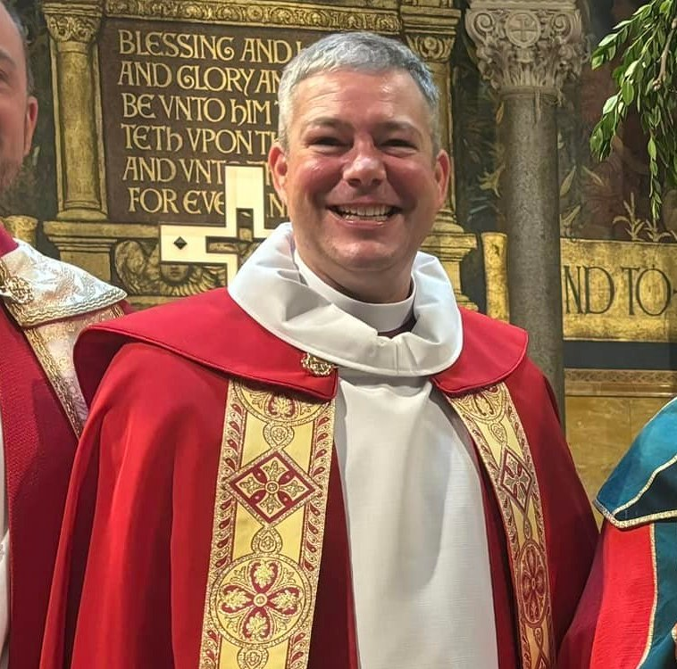
Synod Council
Ms Tracey Beasley
Synod Vice-President
The Rev. Karl Richard
Secretary
Ms Janet Neff
Treasurer
The Rev. Bryan Penman
Bishop

Slide 30
Synod Council
Structure
Executive Council
Elected Lay and Rostered Leaders
Conference Representation

Slide 31
Synod Council
Purpose
This synod, in cooperation with the churchwide organization, shall bear primary responsibility for the oversight of the life and mission of this church in its territory. In fulfillment of this role and consistent with policies and procedures of this church, the synod shall:

Slide 32
Synod Council
Provide for pastoral care of congregations and rostered ministers in the synod;
b. Plan for, facilitate, and nurture the mission of this church through congregations;

Slide 33
Synod Council
c. Strengthen interdependent relationships among congregations, synods, and the churchwide organization, and foster relationships with agencies and institutions affiliated with or related to this church as well as ecumenical partners.
d. Interpret the work of this church to congregations and to the public on the territory of the synod.

Slide 34
Synod Council
How to serve – Nominating Committee
This year there are 8 openings through Assembly:
2 Clergy Seat (Pastor and Deacon) term ending 2028
3 Conference Representatives with terms ending 2028
1 Lay Woman, Delaware Conference
1 Lay Woman, NE/NW Conference
1 Lay Man, Upper Montgomery Conference

Slide 35
Synod Council
1 Lay Young Adult ending 2027
1 Lay Youth term ending 2027
Synod Vice President term ending 2029

Slide 36
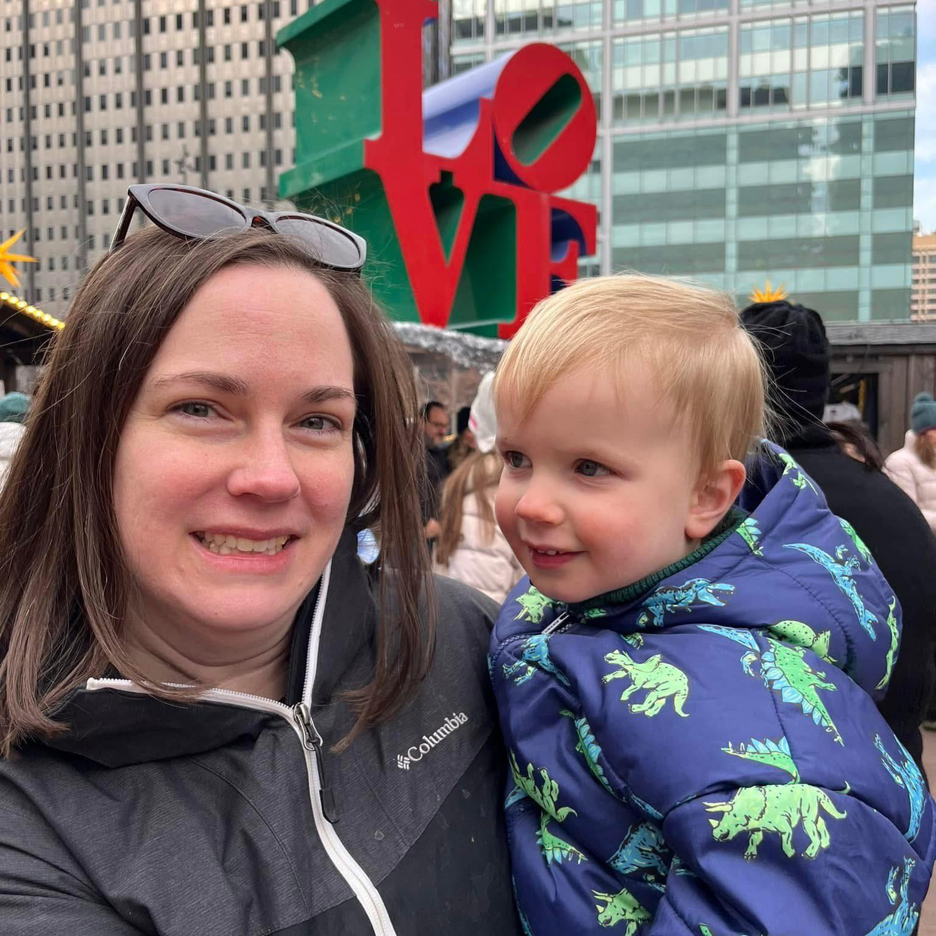
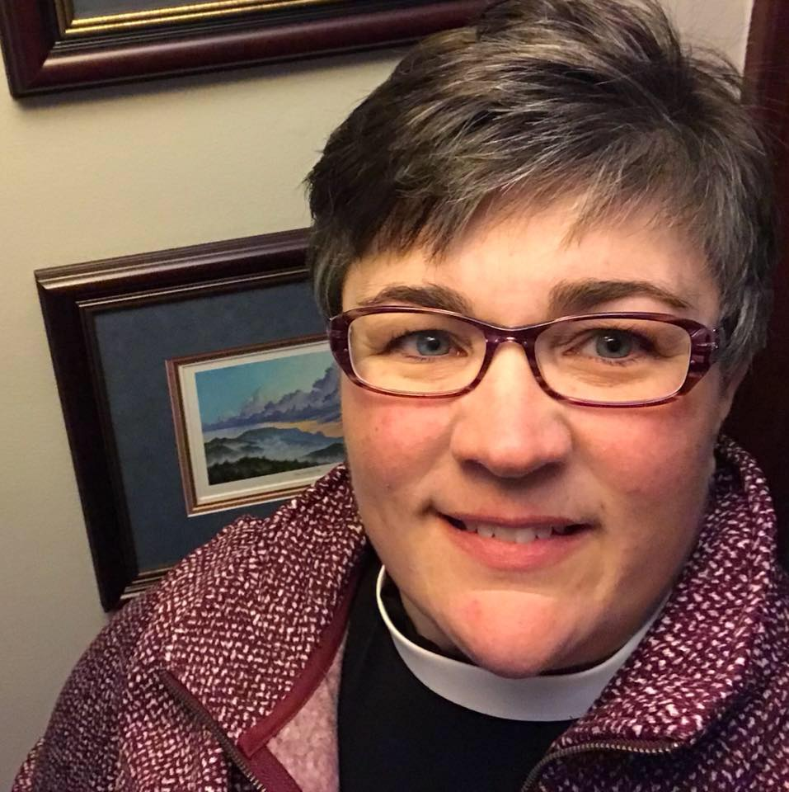
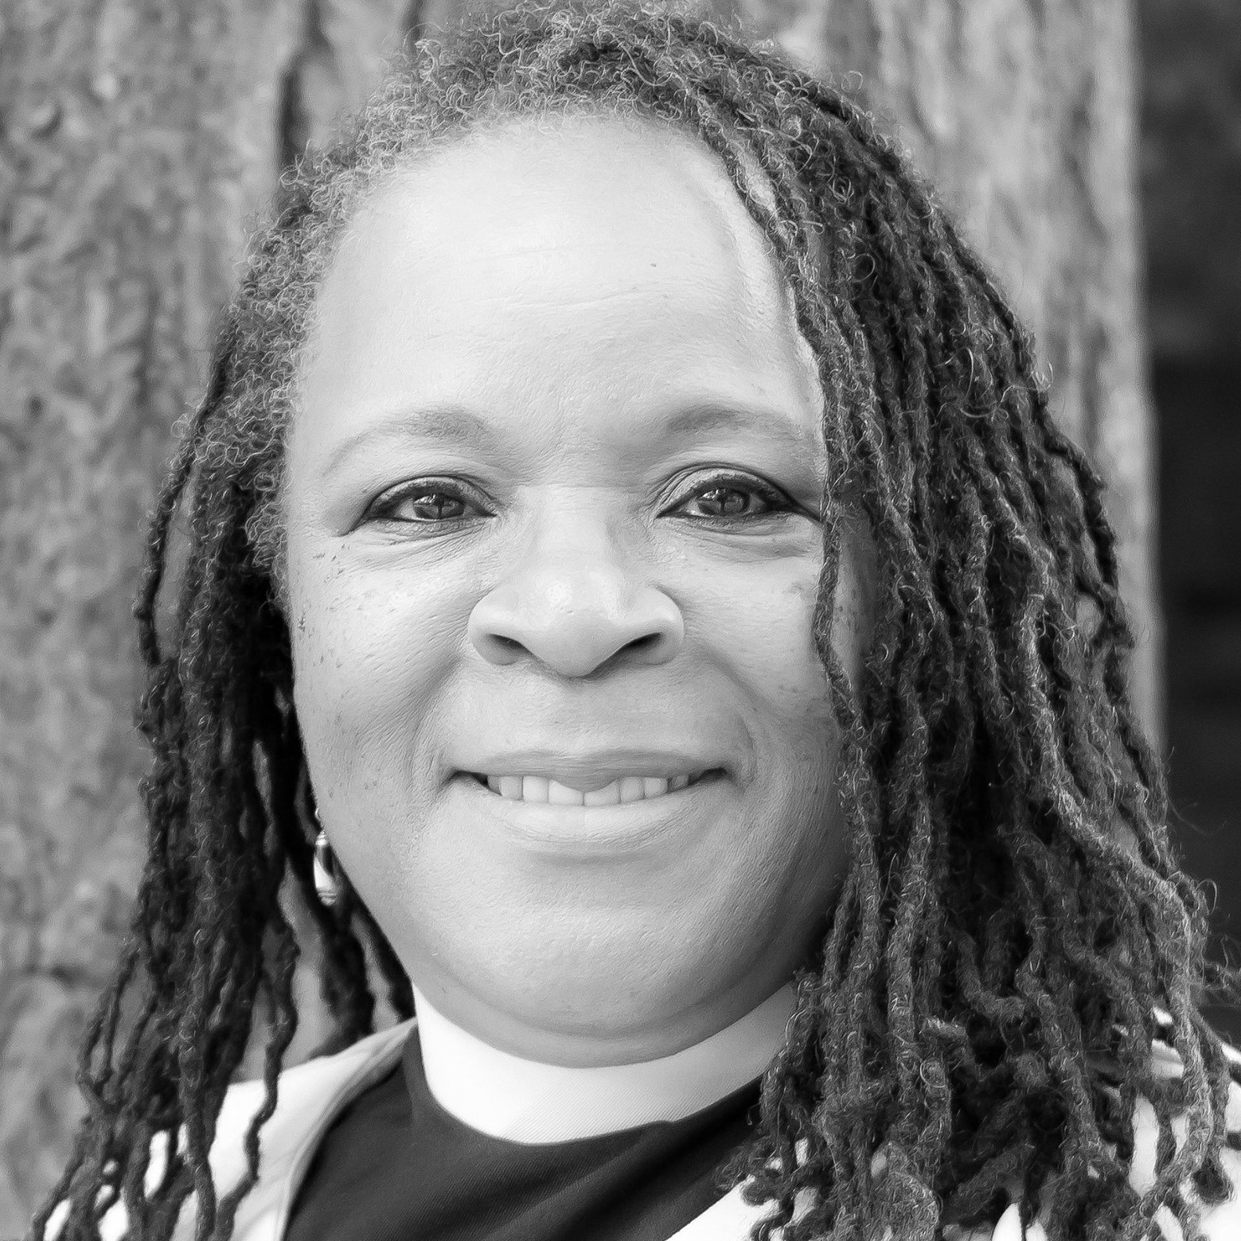
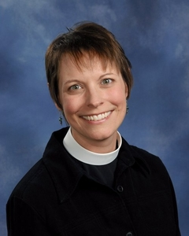
Synod Staff
The Rev. Karen Sease
Assistant for Congregations
The Rev. Paula Lebo
Assistant for Mission Interpretation
The Rev. Linda Manson
Director of Evangelical Mission
The Rev. Erika Wesch
Assistant for Formation

Slide 37
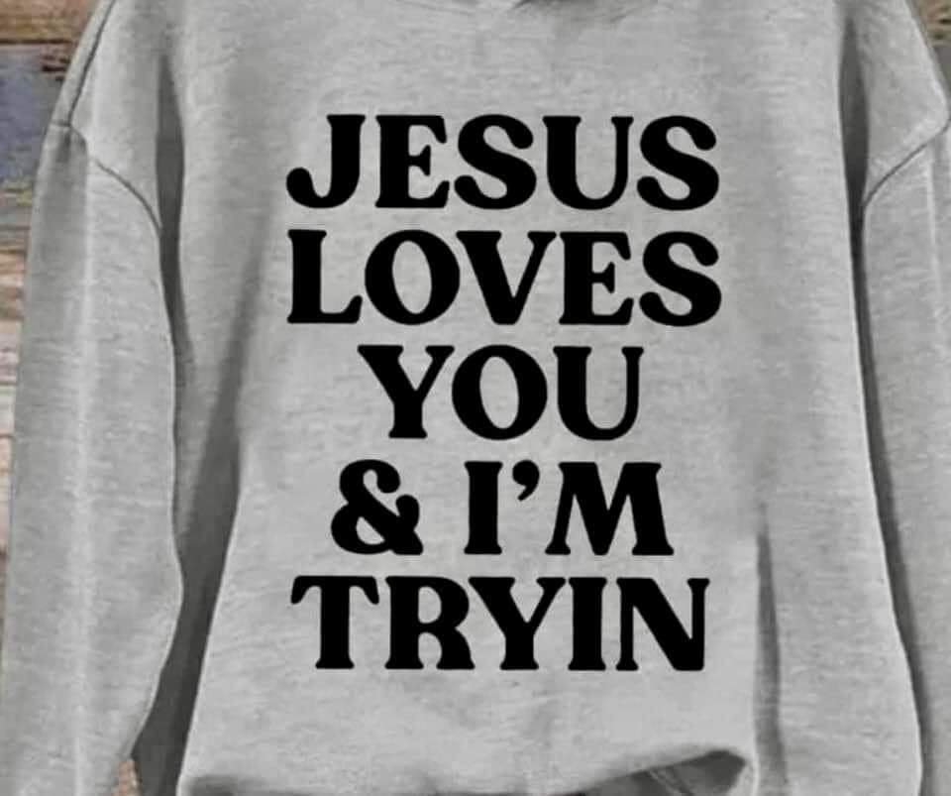
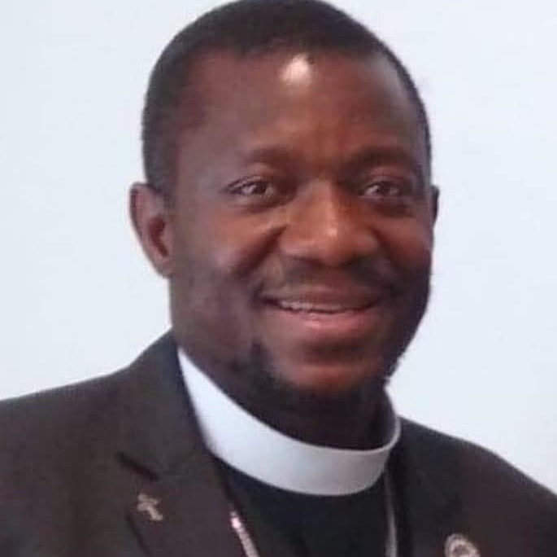
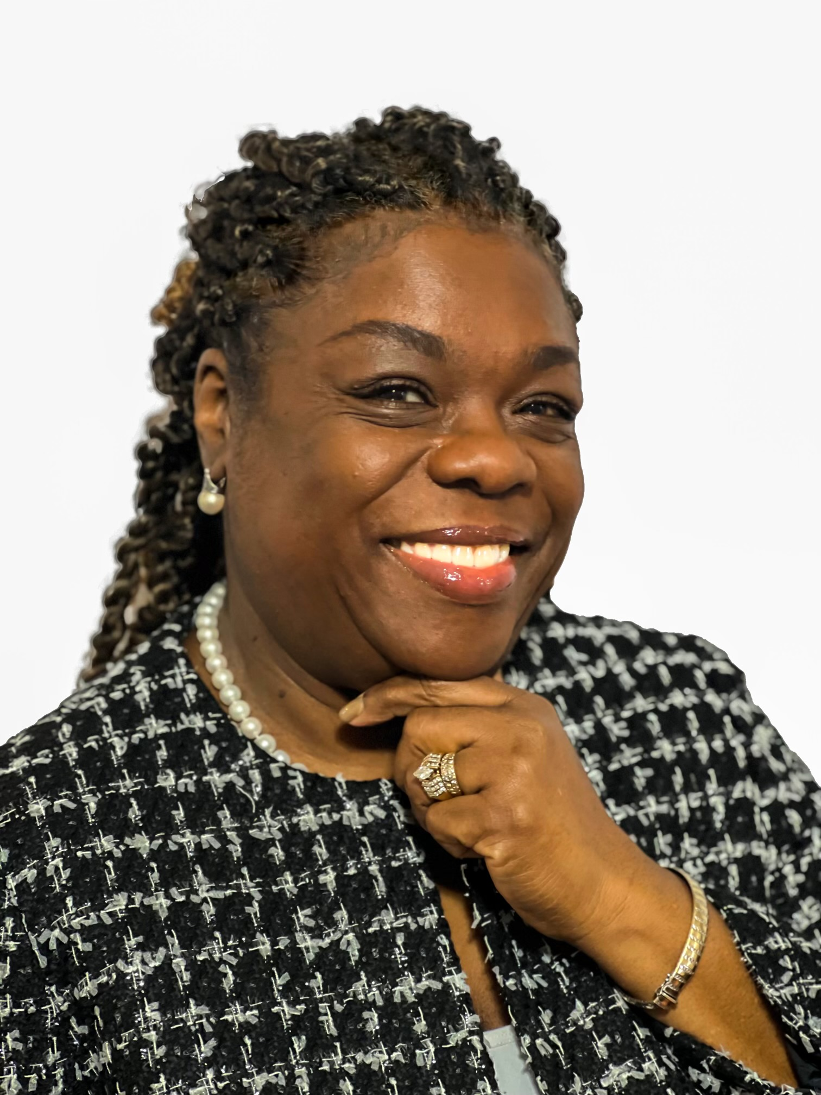
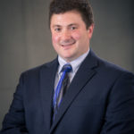
Synod Staff
Vacant
Assistant for Youth and Young Adult
The Rev. Dr. Moses Suah-Dennis
Director of Evangelical Mission
Ms Yvonne Curtis
Director of Operations
Executive Assistant to the Bishop
Mr. Martin Schwab
Sr. Accountant

Slide 38
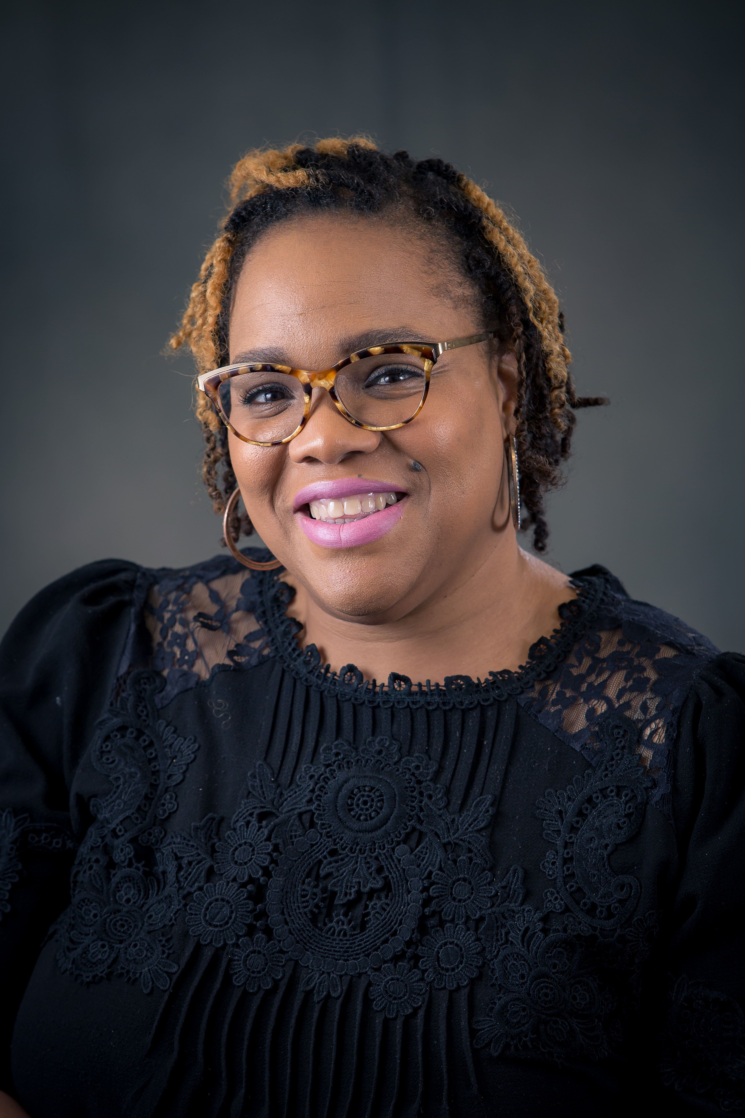
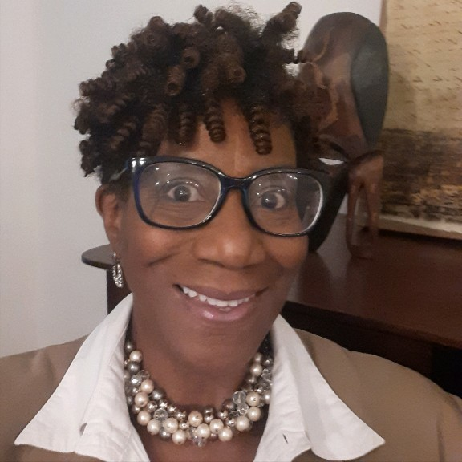
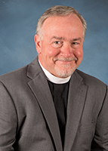
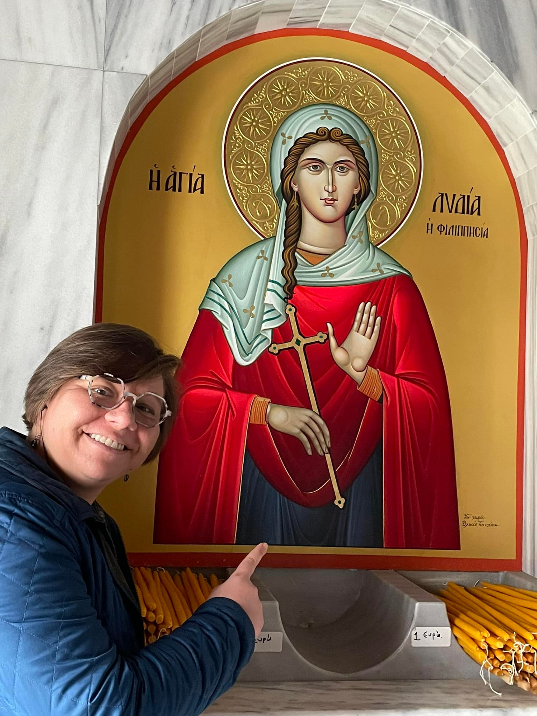
Synod Staff
Ms. Cynta Outterbridge
Admin Support for Communications and IT
Ms. Loretta Green
Admin Support
The Rev. Rick Summy
Program Director for Love Revolution
The Rev. Kayla Sadowy
Grant Evaluator–Love Revolution

Slide 39
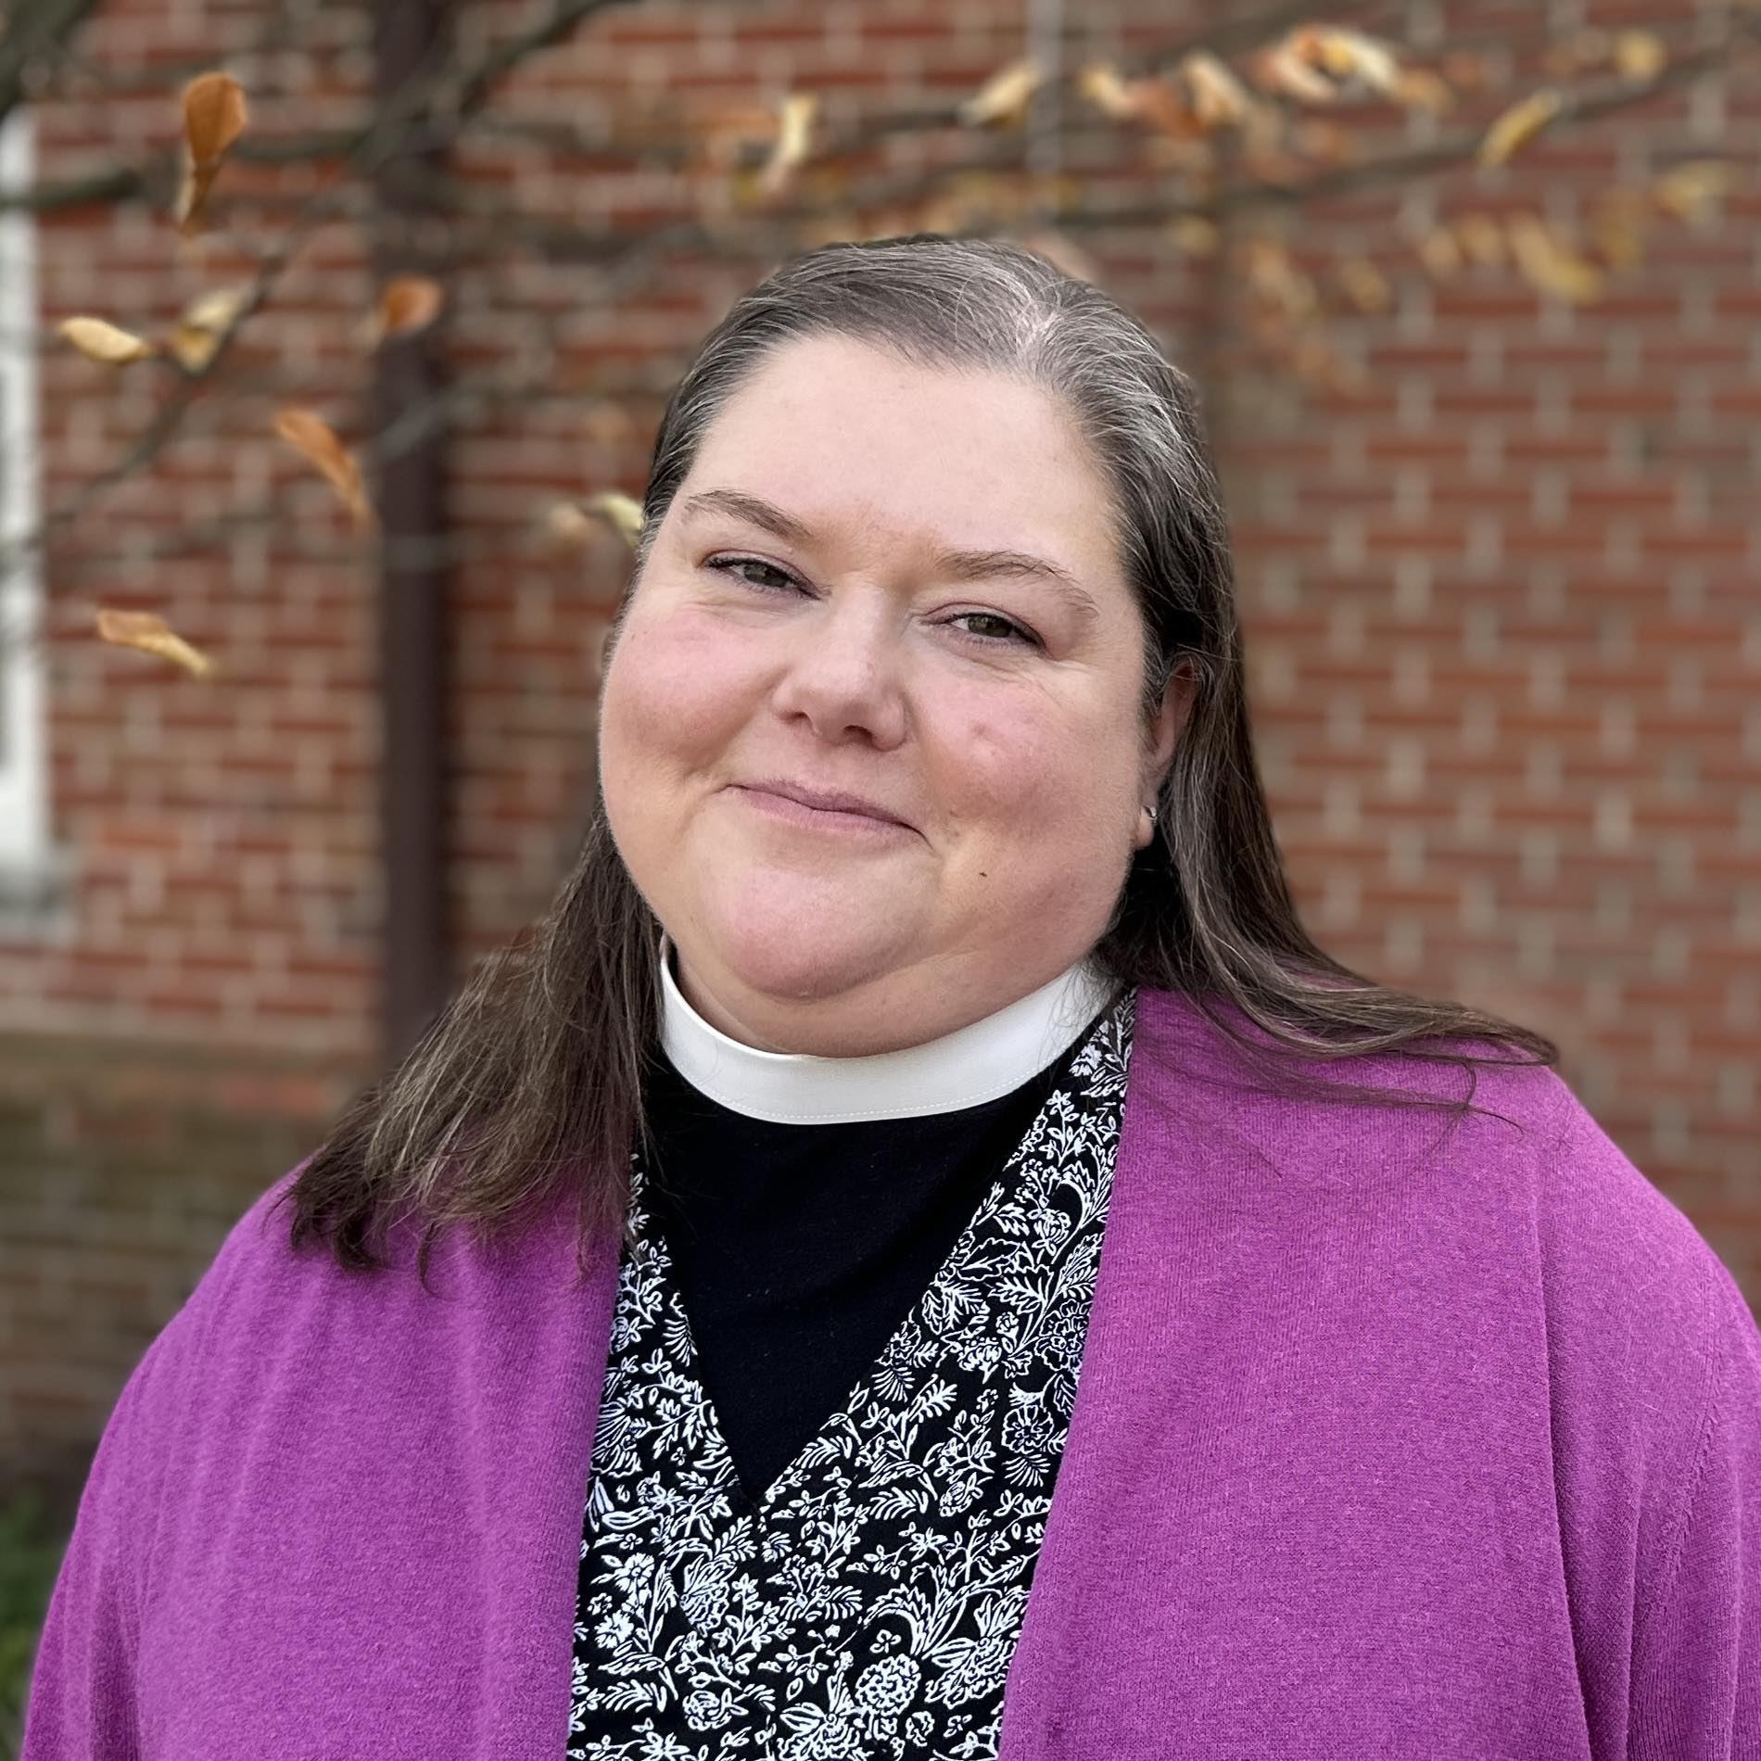
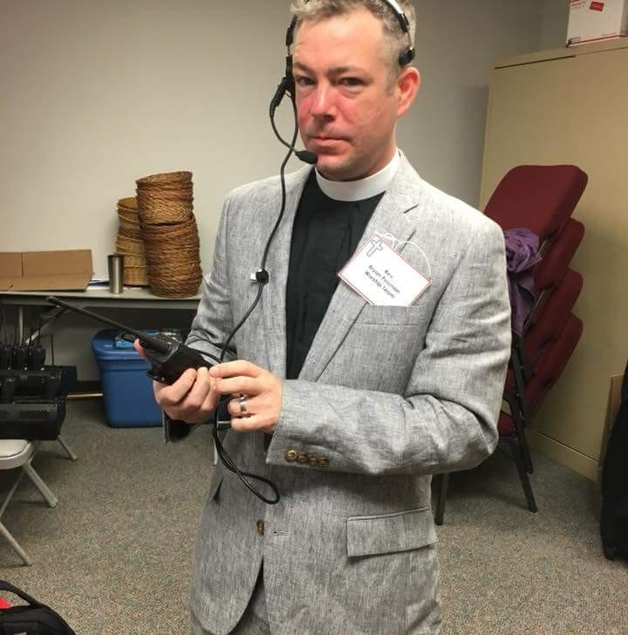
Synod Staff
The Rev. Annemarie Hartner Cook
Program Director – Faith Alive
The Rev. Bryan Penman
Bishop

Slide 40
Deans
Role of the deans
When to call a dean
Central Philadelphia: The Rev. Noah Hepler
Chester: The Rev. Chris Franz
Delaware: The Rev. Marie Sager
Lower Bucks: The Rev. Nathan Krause
Lower Montgomery: The Rev. Julie DeWerth
Northeast/Northwest Philadelphia: The Rev. Daniel Eisenberg
Upper Bucks: The Rev. Erika Wesch
Upper Montgomery: The Rev. Matthew Finney

Slide 41
Love Revolution
Helping our congregations Love God and Love Neighbor:
Deep Dive into the Baptismal Covenant:
LIVE among God's Faithful People
HEAR God's word and share in the supper
PROCLAIM the Good News in both word and deed
SERVE all people following the example of Jesus
STRIVE for justice and peace in all the earth.

Slide 42
Faith Alive
Helping Congregations re-imagine worship from a child-centric lens
Developing resources this year
More to come in the Fall of 2025

Slide 43
Ponder Anew
At Synod Assembly we will be rolling out new resources for congregations in transition.
We have been working with our Interims and our TMDT team to lean into a new future for interim ministry – one that fits the church we are becoming and that is grounded in a sense of vitality.

Slide 44
Synod Assembly
2025 SEPA Synod Assembly
﻿Note new venue and date
Mark your calendars and save the date:
Friday, May 30th and Saturday, May 31st
at Trinity Lutheran Church in Lansdale!

