Slide 1
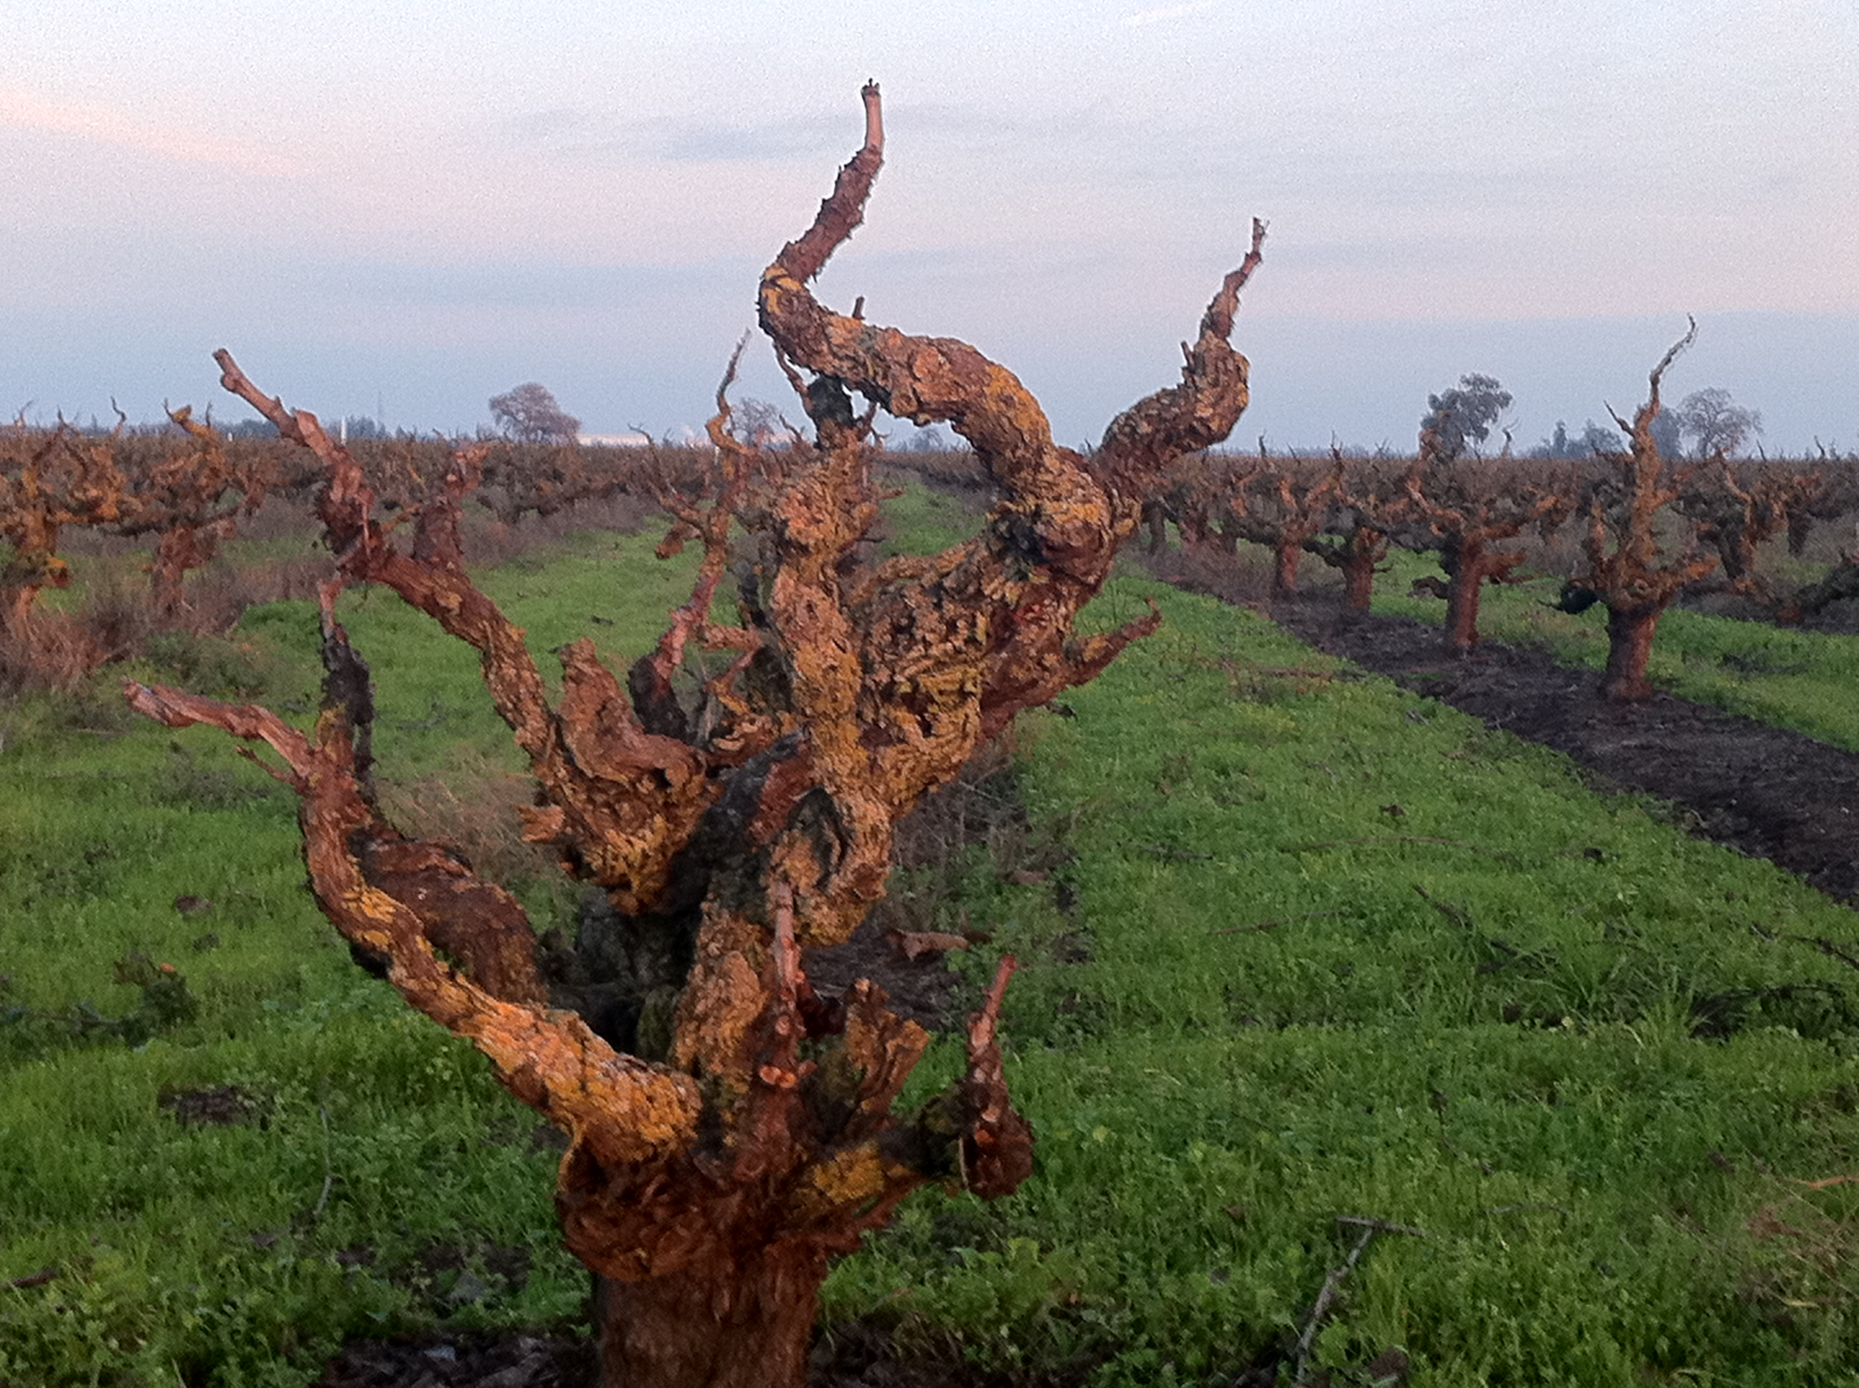
WHERE’S THE FRUIT?

Slide 2
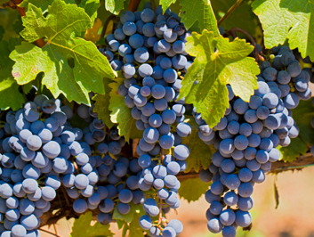
“The fruit of the Spirit is love, joy, peace, patience, kindness, generosity, faithfulness, gentleness, and self control.” Galatians 5:22-23

Slide 3
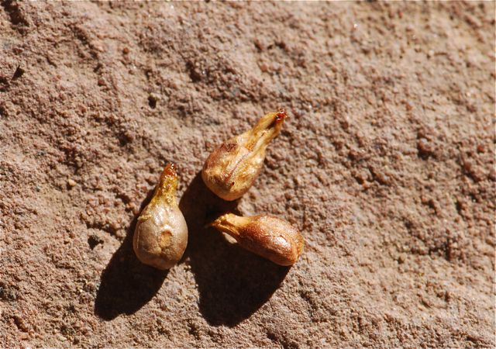

Slide 4
ABUNDANCE & GRATITUDE

Slide 5
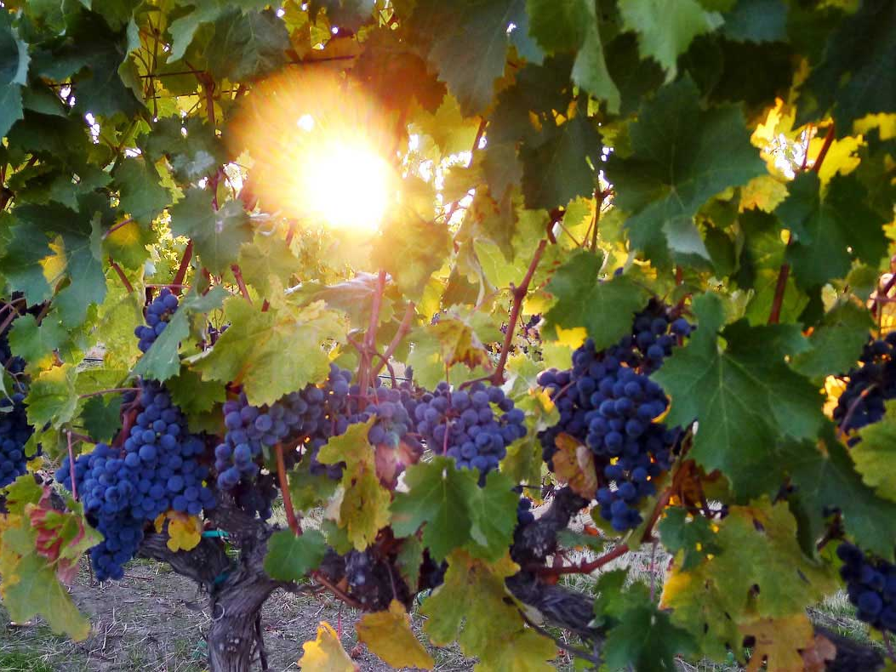
A COMPELLING VISION

Slide 6
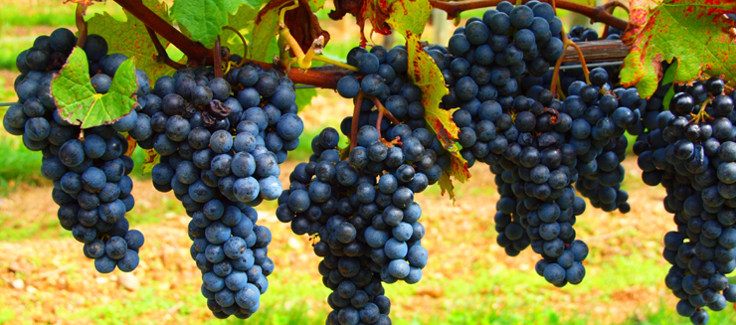
“Where there is no vision, the people perish.
Proverbs 29:18
What does god want to do in & through your congregation?
What will enable you to live out this vision?

Slide 7
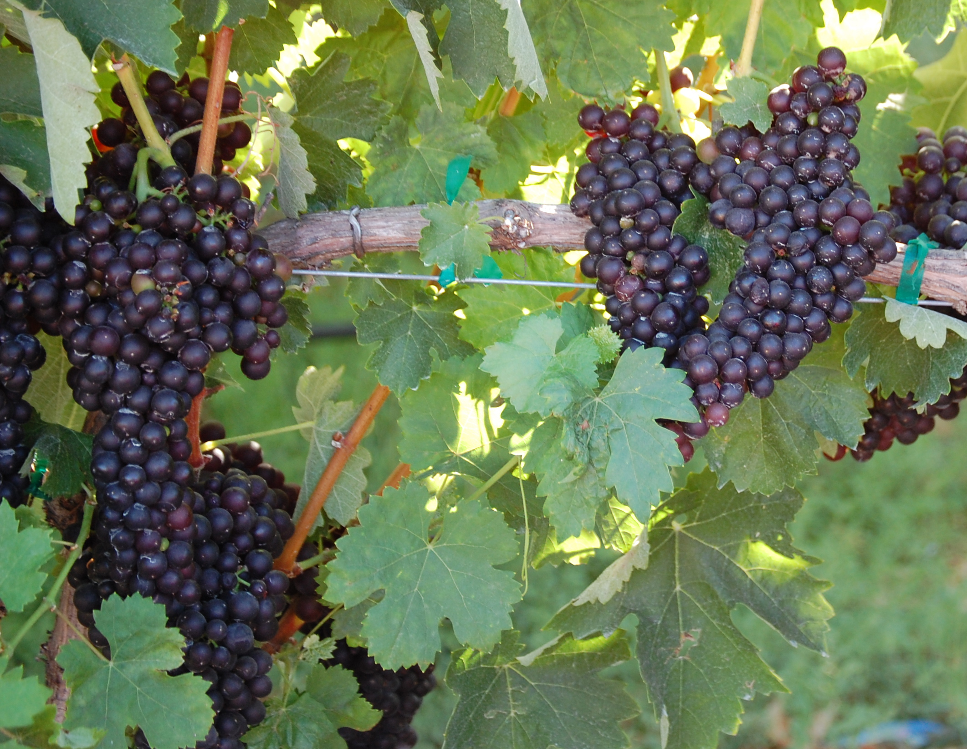
What is unique or distinctive about your congregation?
What is your context?
What are other churches doing that you don’t need to do?

Slide 8
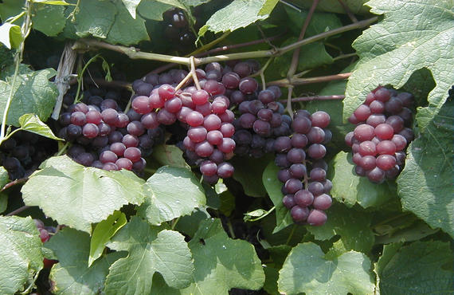
If your congregation ceased to exist, what would the community miss?
What are the needs in your community that you feel uniquely gifted to meet?
Where do you feel God is leading your congregation?

Slide 9
TRANSFORMATIONAL
EXPERIENCES

Slide 10
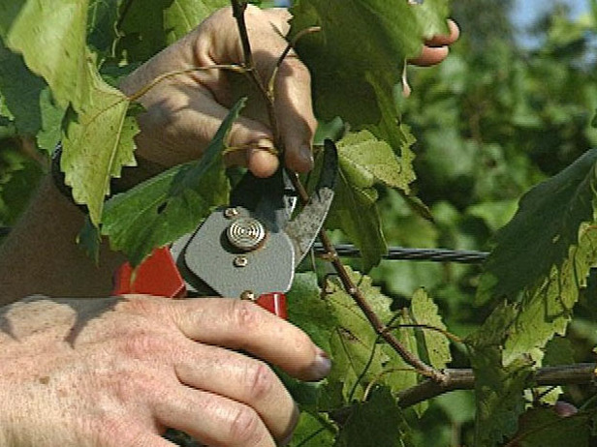
BIBLICAL TEACHING & PREACHING

Slide 11
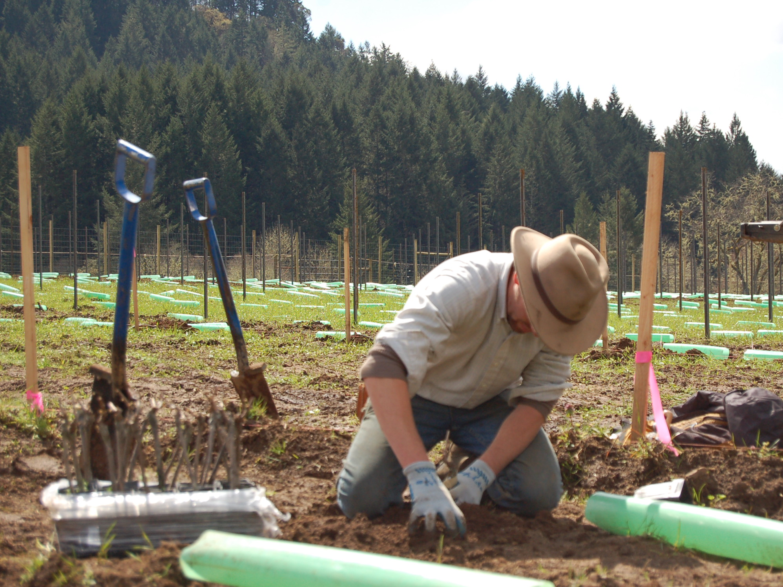
A GENEROUS PASTOR

Slide 12
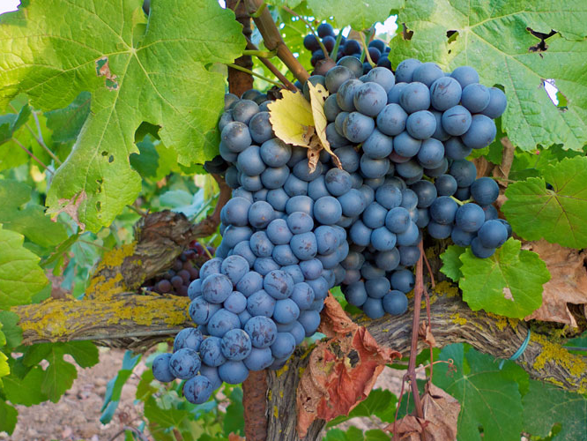
“I am the vine, you are the branches. Those who abide in me and I in them bear much fruit.” John 15:5

